Slide 1
Water Balance Calculations
Basic calculations, commercial and physical losses

Slide 2
Content
Basic Water Balance Calculation
Commercial Losses
Physical Losses
Summary

Slide 3
1. Basic water balance calculation

Slide 4
IWA Water balance
Total System Input Volume | Authorised consumption | Billed authorised consumption | Billed metered consumption | Revenue water
 |  |  | Billed unmetered consumption
 |  | Unbilled authorised consumption | Unbilled metered consumption | Non-revenue water
 |  |  | Unbilled unmetered consumption
 | Water losses | Apparent losses (Commercial losses) | Unauthorised consumption
 |  |  | Metering inaccuracies
 |  | Real losses (Physical losses) | Leakage in transmission and distribution lines
 |  |  | Leakage and overflows at storage tanks
 |  |  | Leakage on service connections up to customer meters
4
Notes:
4

Slide 5
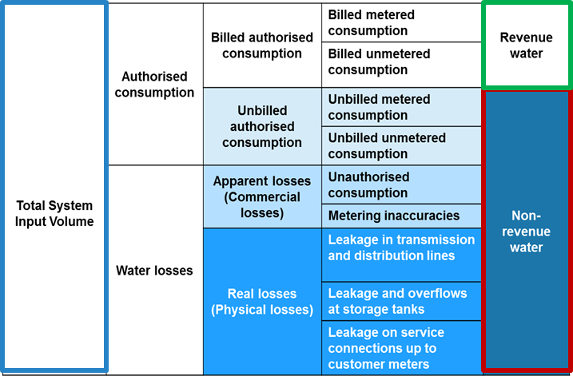
Basic NRW calculation
$$NRW \left[\frac{\frac{liter}{connection}}{day}\right]=\frac{\left(liter NRW)/{day}\right.}{\# connections}=\frac{\left(liter water supplied)/{24}h−(liter water paid)/{24}h\right.}{\# connections}$$
$$(liter water supplied)/{24}h$$
$$=(liter water supplied)/day∗ \frac{24h}{average daily supply time}$$
*Expressing NRW as a percentage of system input volume is a misleading and imprecise method, particularly in systems with intermittent supply and very low operating pressures. However, percentages may be used when looking internally at the improvements made throughout a project
5
Notes:
5

Slide 6
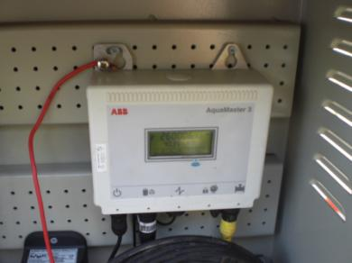
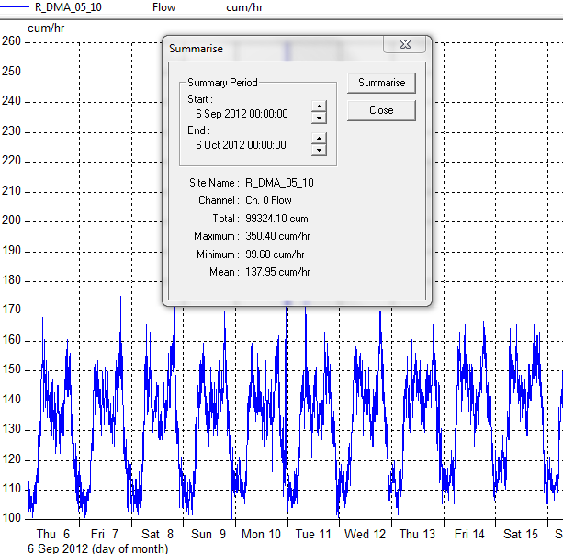
DMA Water Supply Input Volume
The volume of water entering a DMA over a fixed period of time
Calculated by:
Physically reading the DMA’s in- and outgoing meters at the start and end of a certain period (i.e. two weeks or one month)
Analysing the flow data at the office (if meter fitted with GPRS / SMS)
Try to coincide the period of time with the DMA billing period to be able to compare input volume with billed volume

Slide 7
DMA Billed Water Consumption
The volume of billed water in a DMA over a fixed period of time
Calculated by:
Billed volume taken from the monthly billing database
Reading customer meters in a coordinated action
Try and read the customer meters over the same period as the standard cycle

Slide 8
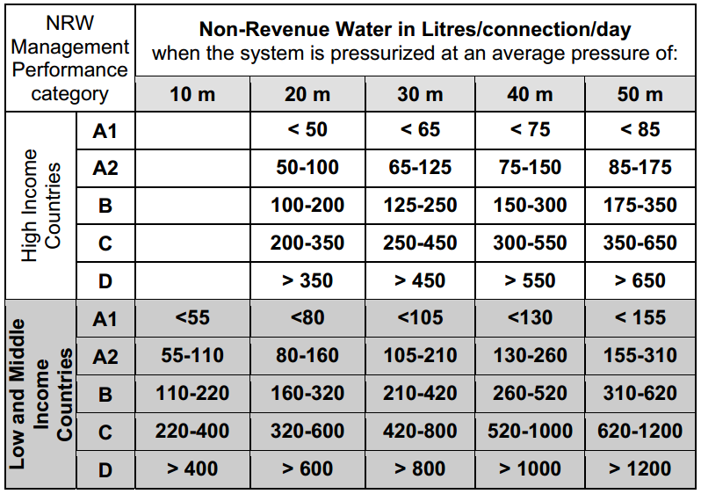
International NRW assessment
Category A1: potential for further NRW reductions is small
Category A2: Further NRW reduction may be uneconomic
Category B: Potential for marked improvements
Category C: Poor NRW record; tolerable only if water is plentiful and cheap
Category D: Highly inefficient; a comprehensive NRW reduction program is imperative and high-priority

Slide 9
2. Commercial losses

Slide 10
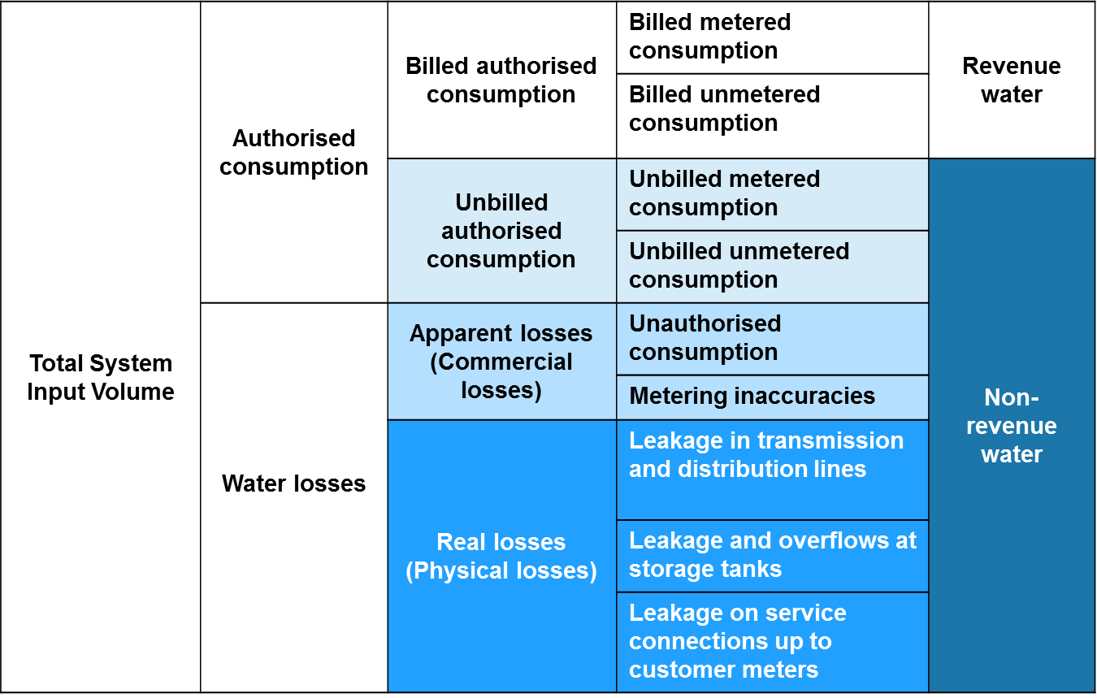
Key components of commercial loss

Slide 11
Key components of commercial loss
Unbilled Authorised Consumption | Water legitimately consumed but not billed, such as: Water fountains; Pipe and sewer flushing; Watering parks and gardens; Public drinking fountains; Fire fighting hydrants
Unauthorised Consumption | Legitimate connections that were never entered into the billing system and are therefore never invoiced (intentional and accidental) Permanent or temporary meter bypass Illegal connections Illegal use of fire hydrants
Meter Inaccuracies | Volume under-recorded by revenue meter due to its condition Over-sized revenue meters Meter tampering (water theft)
Meter Reading Errors | Corruption meter readers (collusion with customers) Meter reading errors (mistakes, or unreadable meters)
Accounting Errors | Data handling errors billing department Bills sent to wrong address

Slide 12
Estimation of commercial loss
Elements of commercial (apparent) water loss
Commercial Loss Component | Data Source
Unbilled authorised consumption | Data from billing department if metered (fire hydrants, pipe flushing, etc.)
Billing errors | Thorough process analysis and analysis of billing data and database: check billing database against actual meter readings; check GIS property number v actual property in DMA v billing database
Illegal connections | Check GIS property number v actual property in DMA v billing database
Meter inaccuracy – age | Meter audit: test old meters (sample calibration) (on average meters under-read 5%)
Meter inaccuracy – class | Meter audit: test class B or lower meters (sample calibration)
Meter inaccuracy – size | Meter audit: check if meters are sized correctly
Meter inaccuracy – installation | Meter audit: check if meters are installed correctly
Meter inaccuracy – tampering | Analyse information from meter reading / meter replacement team
Data handling errors | Meter reading audit

Slide 13
3. Physical losses

Slide 14
Key components of physical loss

Slide 15
Estimation of leakage in a DMA
There are two methods to calculate the leakage volume in a DMA:
Top-Down – subtract the Commercial Losses from the NRW
Bottom-Up – Measure the Minimum Night Flow and subtract the Legitimate Night Flow applying a pressure correction factor
Top-Down method is easier to calculate, but less accurate as many of the Commercial Loss components are estimated
Bottom-Up method requires complex measurement, but gives an accurate leakage figure
Best practice is to use both methods and compare as a ‘check’

Slide 16
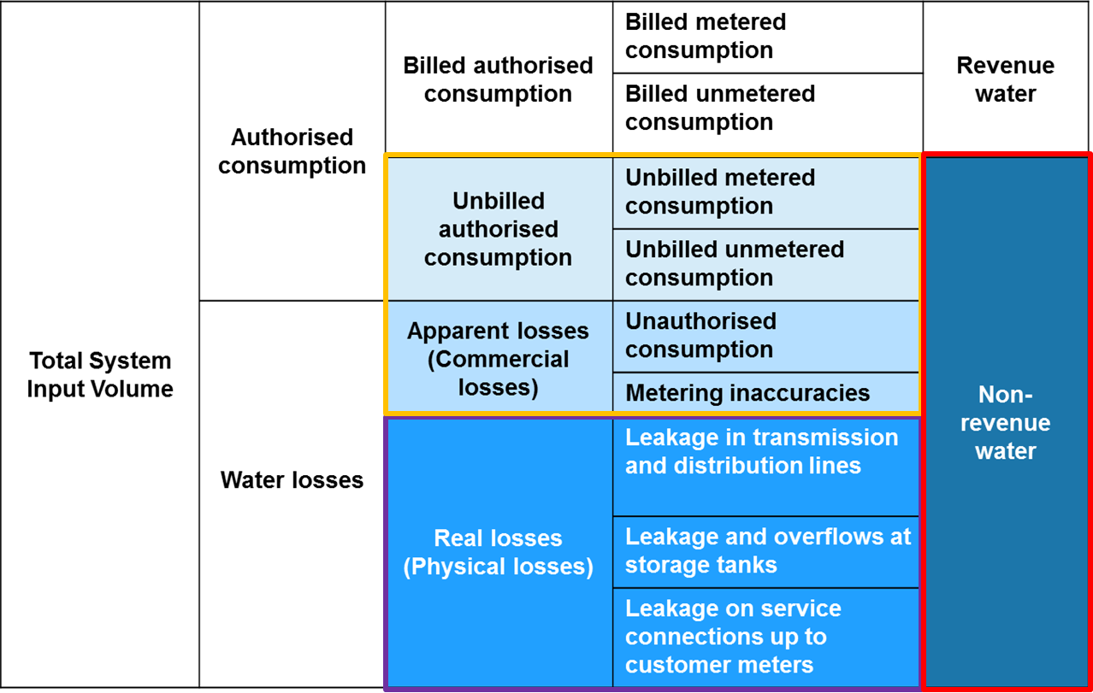
Estimation of leakage: top-down method
To calculate an estimate of the physical losses, subtract the commercial losses from the NRW
$$NRWphys \left[\frac{\frac{liter}{connection}}{day}\right]=NRW \left[\frac{\frac{l}{c}}{d}\right]−NRWcomm \left[\frac{\frac{l}{c}}{d}\right]$$

Slide 17
Estimation of leakage: bottom-up method
The Minimum Night Flow (MNF) is the lowest hourly average flow into the DMA over a 24-hour period,
MNF is usually obtained between 2 and 4am, when most tanks have been filled and users are asleep
The Legitimate Night Flow (LNF) is the customer minimum night consumption at the time of minimum night flow
Domestic customers – toilet flushing, washing machines etc; use a standard legitimate night time factor, or measured sample
Large nightly users (such as night clubs or industries) – manually read or log their meter or use a portable meter
The Net Night Flow (NNF) is the DMA leakage at the time of minimum night flow: what remains after subtracting the LNF from the MNF
Some of the leakage occurs on the customer’s premises and therefore is not part of the utilities NRW. As such, the NNF should be divided into ‘Utility leakage’ and ‘Customer leakage’

Slide 18
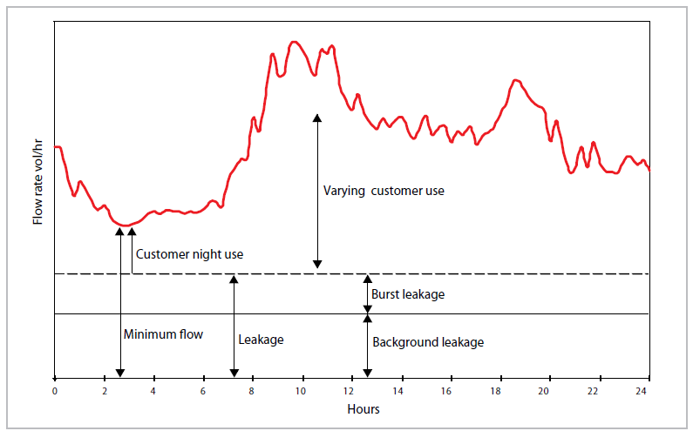
Estimation of leakage: bottom-up method
Identify the MNF (using a logged DMA meter)
Identify the typical LNF
Calculate the NNF = MNF – LNF
Estimate the ‘Utility leakage’ UNNF = NNF – ‘Customer leakage’
As leakage is proportional to pressure, to represent the average leakage through the day the UNNF should be corrected with a pressure factor (pf), typically pf = average daily DMA pressure / average MNF pressure
Average DMA leakage
= UNNF*pf
Peak demand = lowest DMA pressure = lowest level of daily leakage
Night demand = highest DMA pressure = highest level of daily leakage
Varying Customer Demand
Legitimate Customer Night Use
Minimum Night Flow
Leakage Varying with DMA Pressure throughout the Day

Slide 19
Estimation of leakage: bottom-up method
Minimum Night Flow into DMA (MNF) | = 13 m³/hour
Number of domestic connections in DMA | = 500
Average DMA occupancy rate | = 5
Legitimate Domestic Night Use factor¹ | = 1.7 litres / person / hour
Legitimate Domestic Night Use = 500 x 5 x 1.7 / 1000 | = 4.25 m³/hour
Measured Exceptional Night Use | = 1 m³/hour
Night leakage (L₀) = 13 – 4.25 – 1 | = 7.75 m³/hour
Measured night pressure (P₀₎) | = 25 metres
Measured average DMA pressure (P₁) | = 15 metres
Therefore average DMA leakage (L₁) = 7.75 x (15/25) | = 4.65 m³/hour
Or, average DMA leakage (L₁) | = 111,6 m³/day
¹ IWA Standard Factor
Compare this result with the result of the Top-Down calculation

Slide 20
4. Summary

Slide 21
Water balance calculations
In order to understand NRW quantitative as well as qualitatively, it is essential to make a calculation of the water balance: the ratio of water produced to water sold
While making the water balance, where possible, one should distinguish between the different causes of water loss: technical, administrative, illegal consumption, authorised consumption, etc.
Depending on the resources available on can make water balance calculations in different ways
The basic NRW calculation is easy, but gives only information on the total level of NRW. The outcome can be used to make an international comparison on NRW performance
Estimates can be made of commercial losses by thoroughly studying the customer billing database and by field surveys
Physical loss can then be calculated using total – physical loss (top-down) or by more detailed field study (bottom up)

