Slide 1
Organisational NRW Management

Slide 2
Content
Organisational measures
Key Performance Indicators
Water Balance Calculations
Plan-Do-Check-Act Cycle

Slide 3
Organisational measures
Steering committee, nrw task team

Slide 4
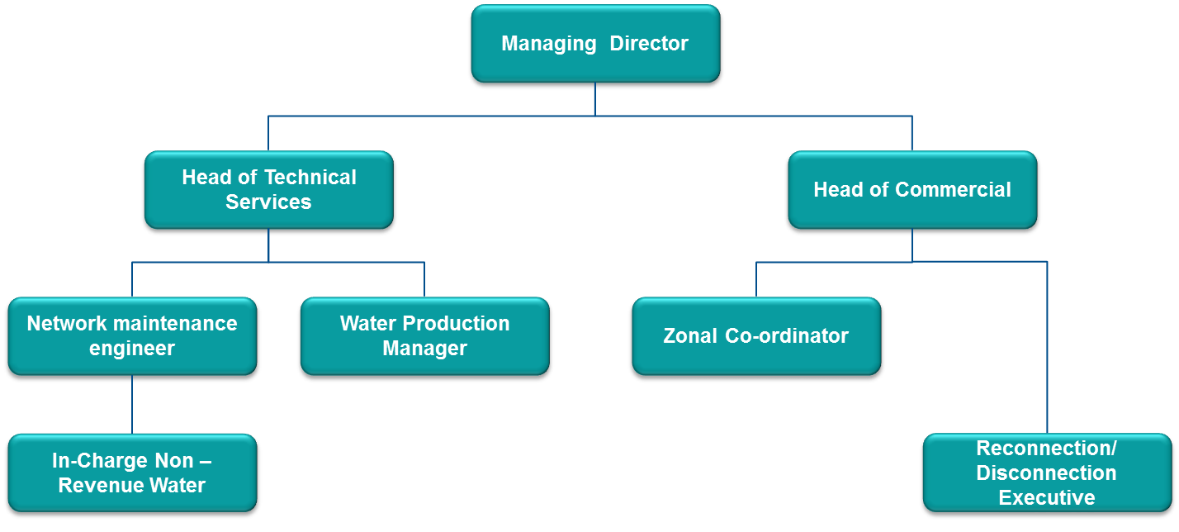
Steering Committee
A NRW ‘steering committee’ consist of a group of people (often from the management team, but also that are in direct contact with the employees) that can drive, accelerate and check the work in progress and results that are achieved, by:
Integrating NRW activities in the organizational structure of the company, make decisions and approve plans
Making resources available and holding people accountable

Slide 5
NRW task team
A NRW task team consisting of commercial and technical department staff will help to:
Have tasks and responsibilities well defined
Create contact points, for managers, other employees as well as customers
Create buy-in among staff members and raise the feeling of ownership through all departments and levels of the company
The NRW task team should be coordinated by an experienced NRW ‘caretaker’, who can write/update the NRW management plan, initiate, drive and monitor NRW management activities and report back to management.

Slide 6
NRW task team coordinators
Function | Tasks
Caretaker | Write/update NRW approach (spanning several years) Initiate, drive and monitor NRW management activities Ensure quality work Report to management
GIS specialist(s) | Update the complete GIS database of the DMA (including customer’s GPS locations) Help to select suitable areas for DMAs Report status to team caretaker
Technical specialist | Support with planning and preparing DMAs Coordinate technical team Report all activities to team caretaker
Commercial specialist | Drive continuous improvement of the customer database Coordinate creditors and debtors Report status to team caretaker

Slide 7
NRW task team members
Function | Tasks
Zone analysts | Executing house visits Register meter readings Detect leakages and other problems (such as illegal connections and payment problems) Locate all clients using GPS locations.
Plumbers | Make adjustments to the supply network, installing bulk water meters and valves Detect leakages and other problems (such as illegal connections and incomplete installations) Repair located leakages, install/repair water meters and solve other technical problems within the DMA
Leakage surveyors | Detect leakages and other problems (such as illegal connections) Possibly repair located leakages (if only temporarily until more technical support is available)
Creditors | Update the database of the DMA and verify all customers Check invoices and verify if all customers in the area receive them Inform the debtors on defaulters
Debtors | Update the database of the complete area. Register all consumers that do not pay their bills or that are disconnected Send and collect fines Check if fines are paid and if defaulters are disconnected

Slide 8
Key Performance Indicators
KPIs, monitoring

Slide 9
Key Performance Indicators (KPI)
Key performance are (measurable) indicators that help a utility to:
Better understand water losses
Define and set targets for improvement
Measure and compare performance
Develop standards
Monitor compliance
Prioritise investments

Slide 10
KPIs for NRW
Main KPI’s:
NRW
Total water produced
Total water sold
Technical PI’s
Number of leaks and bursts reported
Number of leaks and bursts repaired
Average repair time
Average pressure
Amount spent on pipeline maintenance
Number of leak detection surveys
Number of leaks detected
Commercial PI’s:
Number of meters read
Number of meters tested
Number of meters replaced
% of unmetered connections
Stolen meters
Defective meters detected
Illegal cases investigated

Slide 11
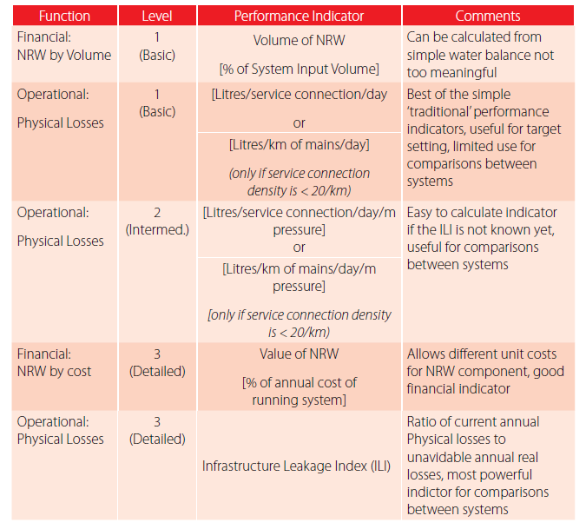
KPIs for physical losses
NRW in %: frequently used. However, it favours utilities with high consumption, low pressure, and intermittent supply
ILI: an excellent indicator of physical losses, one that takes into account how the network is managed

Slide 12
KPI monitoring
KPIs can be measured to keep track of performance and analysed to understand the impact on utility performance.
Different reporting methods can be chosen. It is useful to use software tools that can analyse and visualise the data.
12

Slide 13
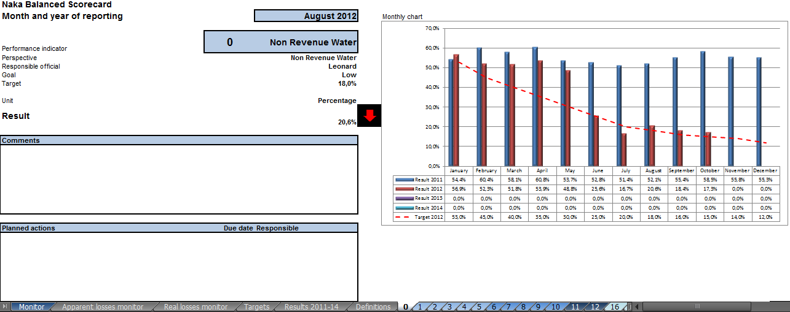
NRW MIS Scorecard Monitor

Slide 14
Plan-Do-Check-Act Cycle

Slide 15
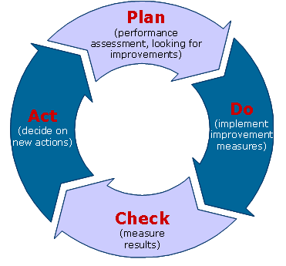
Plan-Do-Check-Act Cycle
To keep track of performance and learn from experiences, it helps to initiate regular Plan, Do, Check, Act (PDCA) meetings with the key people involved (i.e. steering committee, NRW task team)

Slide 16
PDCA: Check
Do
Check
Collecting data
Data input
Data check
Data analysing
Create actions
Implement actions
Plan
Act

Slide 17
Collecting Data
1.
2.
Ongoing process
3.
Every month same data (KPIs)
Standard template, one person to check final version reports

Slide 18
PDCA: Check
Do
Check
Collecting data
Data input
Data check
Data analysing
Create actions
Impement actions
Plan
Act

Slide 19
Data Input
1.
Put data in MIS Tool
2.
Do it consistently (by one person only)
3.
Make sure the data is complete

Slide 20
PDCA: Check
Do
Check
Collecting data
Data input
Data check
Data analysing
Create actions
Implement actions
Plan
Act

Slide 21
Data Check
1.
Is the data correct?
2.
Objective view on data
3.
Done by the same people monthly

Slide 22
PDCA: Act
Do
Check
Collecting data
Data input
Data check
Data analysing
Create actions
Implement actions
Plan
Act

Slide 23
Data Analysing
1.
Compare data previous month and current month to explain NRW
2.
Draw conclusions from the data analysis
3.
Discuss monthly with NRW team

Slide 24
PDCA: Plan
Do
Check
Collecting data
Data input
Data check
Data analysing
Create actions
Implement actions
Plan
Act

Slide 25
Create Actions
Specific
Measurable
Accepted
Realistic
Time bound
1.
Create an action plan from the conclusions drawn from data analysis
2.
Make sure actions are SMART, make people responsible and accountable
3.
Record actions in meeting

Slide 26
PDCA: Do
Do
Check
Collecting data
Data input
Data check
Data analysing
Create actions
Implement actions
Plan
Act

Slide 27
Implement Actions
1.
Execute actions according to plan, use actionlist in MIS Tool
2.
Keep regular team meetings to discuss the status, problems and successes
3.
Report the actions undertaken and hold each other responsible

Slide 28
Multi-year NRW strategy

Slide 29
Multi-year NRW strategy framework
Organize discussions to hear opinions (of different departments and cadres of staff) on current operations, previous NRW reduction projects, existing NRW management schemes and ideas on how to plan and run the current project
Create due awareness
Create a guiding team
Training on NRW management (for all departments and cadres of staff) following a training Decide on a project area
Set/prioritise targets considering available human resources and budget; define performance indicators
Organise human resources: create a project team
Collect needed materials
Create DMAs; study DMAs
Plan and implement NRW reduction measures
Consider appropriate scaling-up approach; embed NRW management in utilities’ standard operations

