Slide 1


Commercial NRW Reduction
Reduction of administrative components

Slide 2
Contents
Introduction
Unbilled authorised consumption
Unauthorised consumption
Meter reading errors
Accounting errors
Important pillars

Slide 3
Introduction

Slide 4
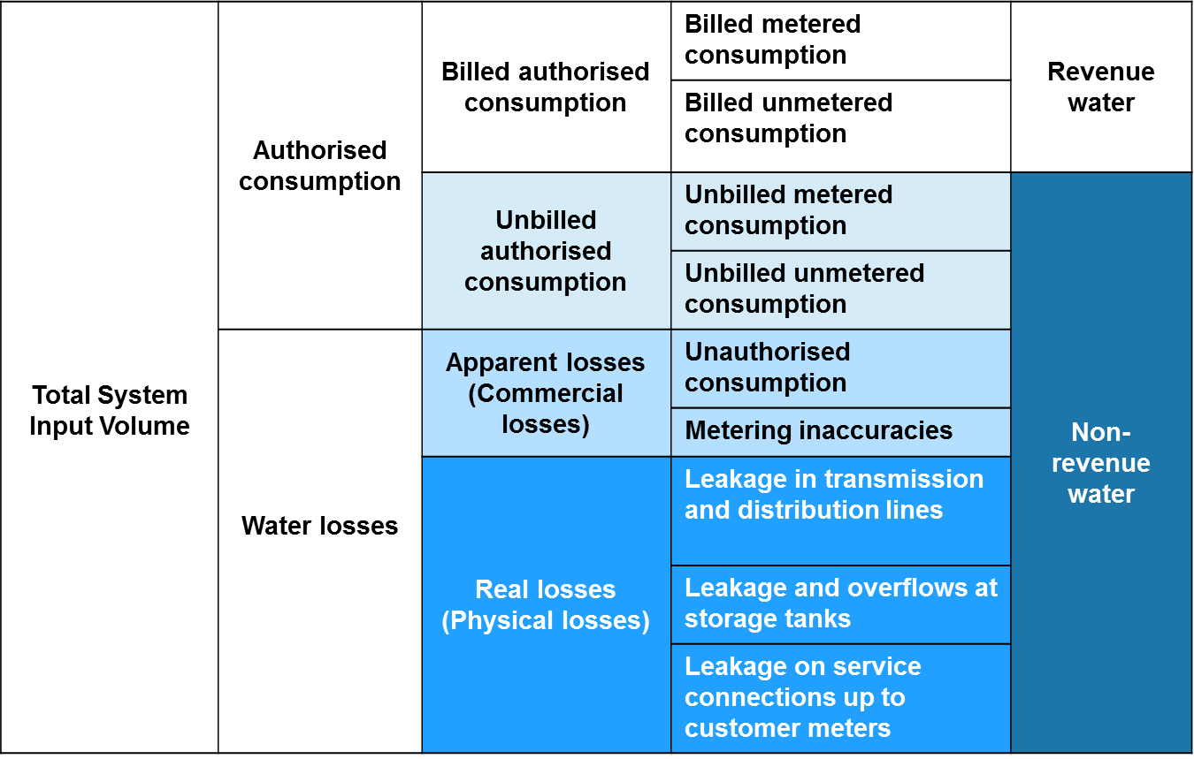
Key components of commercial loss

Slide 5
Key components of commercial loss
Unbilled Authorised Consumption | Water legitimately consumed but not billed, such as: Water fountains; Pipe and sewer flushing; Watering parks and gardens; Public drinking fountains; Fire fighting hydrants, Exempted customers (metered or unmetered)
Unauthorised Consumption | Legitimate connections that were never entered into the billing system and are therefore never invoiced (intentional and accidental) Permanent or temporary meter bypass Illegal connections Illegal use of fire hydrants Meter tampering
Meter Inaccuracies | Volume under-recorded by revenue meter due to its condition or installation Over-sized revenue meters
Meter Reading Errors | Corruption meter readers (collusion with customers) Meter reading errors (mistakes, or unreadable meters) Estimated readings
Accounting Errors | Data handling errors billing department Bills sent to wrong address

Slide 6
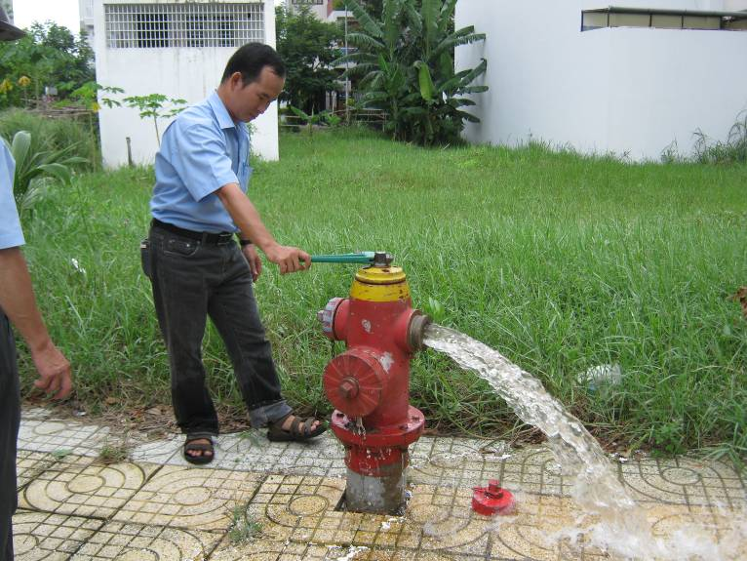
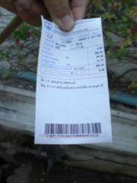
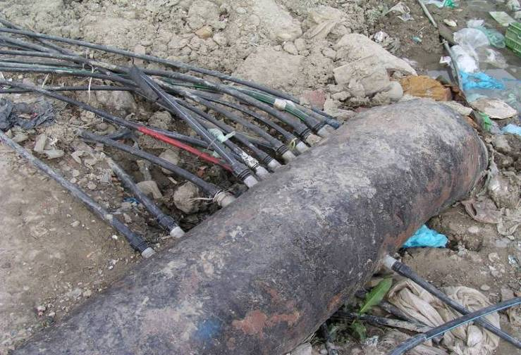
Approach to commercial loss reduction
Commercial NRW includes technical and administrative components. In this presentation we will focus on the reduction of administrative components.
Unbilled Authorised Consumption
Unauthorised Consumption
Meter Inaccuracies
Meter Reading Errors
Accounting Errors

Slide 7
2.Unbilled authorised consumption

Slide 8
Key components unbilled authorised consumption
Unbilled authorised consumption is in theory the only element of NRW that a utility commits to voluntarily (although it may be sometimes enforced by law) and therefore does not necessarily have to be reduced. Eaxmples of components of water legitimately consumed but not billed are:
Water fountains
Pipe and sewer flushing
Watering parks and gardens
Free public drinking fountains
Fire fighting hydrants
Exempted private customers

Slide 9
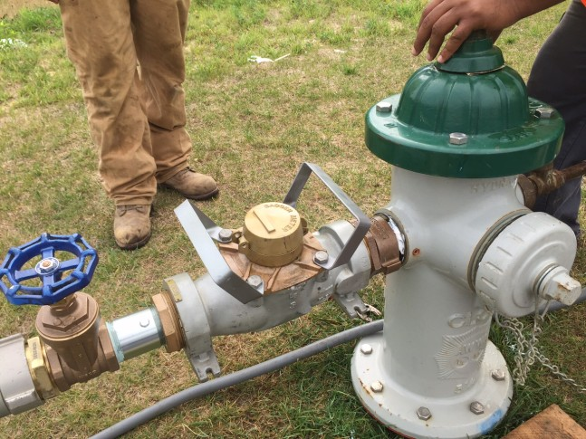
Reducing unbilled authorised consumption
Unbilled authorised consumption may be metered or unmetered. This does not matter for the level of NRW, however, metering does help to calculate of how much water the utility gives away for free and therefore the analysis of the total level of NRW
It is only by knowing and understanding – through metering and analysing – the unbilled authorised consumption that a water utility can choose to reduce its NRW
Image: WTOP

Slide 10
3.Unauthorised consumption

Slide 11
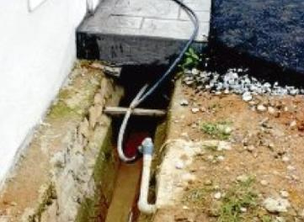
Key components unauthorised consumption
The most regularly occuring components of unauthorised consumption are:
Legitimate connections that are never invoiced, for example because:
  The new connection was never entered into the billing system
  The billing system was not updated with customer details, such as people moving home, dis- or re-connections
Illegal consumption, through:
  Meter by-passes
  Meter tampering
  Illegal connections
  Illegal use of fire hydrants
Unauthorised consumption may occur through:
Mistakes on the water company’s side
Illegal activity by the customer
Collusion between water company staff and customers

Slide 12
Reducing not-invoiced customers
One of the components of unauthorised consumption are legitimate connections that are never invoiced because the billing database is not up to date. In order to reduce and manage NRW it is important to regularly clean up the database. This is done by:
Going through the billing database and verifying all customers using
  Meter reader lists to see whether he/she can locate the all customers in his/her area and if addresses correspond
  Collection data to see which customers do not pay and what is the reason for this (do they receive invoices?)
Organise field actions to verify billing database and GIS data:
  For each DMA, take a copy of the billing database and GIS maps showing all properties and their reference numbers
  Walk the DMA; check if the GIS map is up to date and billing database accurate
  Identify properties that mismatch with the GIS plan and billing database
  Identify properties not on billing database; investigate and take action
  Update the GIS plan and billing database

Slide 13
Reducing not-invoiced customers

Slide 14
Reducing illegal consumption
It is important to actively reduce illegal consumption, because:
It causes a loss of revenue to the water company
Connections are likely to be of poor quality. Therefore, they may leak and be a source of contamination
Not actively reducing NRW may encourage others to illegally connect and aggravate the problem
NB Illegal consumption usually happens at a much larger scale by commercial users

Slide 15
Reducing illegal consumption
Awareness campaigns for customers
  Customers may be affected by water theft as it may cause higher water tariffs and lower water quality
  Good communication with customers is important, so that it is easy for them to contact the water company when they see irregularities (for instance by having a trusted spokesman, or a free and anonymous phone line)
Awareness campaigns for meter readers
  To understand the consequences of water theft
  To be able to recognise illegal connections and meter tampering
  To know how to act when finding illegal connections
Offer good and affordable service to everyone so that there is no need to steal
Organise targeted searches in suspected areas
  Regularly visit large consumers (commercial) and check their installations
  Check temporary water connections at construction sites, etc.
  Metering fire hydrants

Slide 16
4.Meter reading errors

Slide 17
Key components meter reading errors
Meter reading errors (accidental)
  Reading or writing mistakes
  Unreadable meters
Corruption meter readers (intentional)
  Collusion with customers
Estimated readings
  People charged a fixed fee based on an estimated consumption

Slide 18
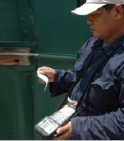
Reducing meter reading errors
Make sure meters are readible (replace unreadable meters)
Communication with customers is important, as they can verify their own bills and inform the company if bills are too high or low
Rotate meter readers to avoid customer collusion
Undertake data analysis
  Is the consumption logical for the (type of) customer?
  Is the consumption of each customer in line with previous consumption of that customer?
  Use software that can highlight outliers
Undertake ad-hoc rounds of data verification in the field
Use hand held meter reading devices to avoid data errors
Reduce (if possible to zero) the number of customers billed based on estimates

Slide 19
5. Accounting errors

Slide 20
Key components accounting errors
Data handling errors billing department
Bills sent to wrong address
Not officially part of the IWA water balance, but an important element in a commercial revenu loss is inefficiency in collection. Even if the Billing-Collection ratio is as high as 87% this means that 13% NRW occurs through non-paying customers (whether calculated in the water balance or not). Therefore we add as a component;
Billing-collection ratio

Slide 21
Reducing accounting errors
Use a good billing database. Robust software can:
  Identify potential data errors
  Make reports of zero-readings
Undertake data analysis
  Is the consumption logical for the (type of) customer? Is the consumption of each customer in line with previous consumption of that customer?
  Use software to highlight outliers
Going through the database and verify all customers using meter reader lists and data from collection
Organise field actions to:
  Verify billing database and GIS data
  Identify meters needing replacement
Use of electronic meter reading devices
Communication with customers is important, as they can verify their own bills and inform the company if bills are too high or low

Slide 22
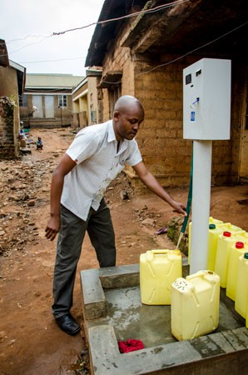
Improving collection efficiency
Reach out to all customers with debt
  Depending on the height of debt, how long it has been standing for and how many warning they already had, disconnect them or give them a deadline for payback
  Work out a payback scheme
Pro-actively engage ‘gate-locked’ consumers
Install pre-paid meters
  They are more expensive and might only be a good solution for public taps
Image: Waterworld

Slide 23
6. Organisation

Slide 24
Tackling administrative components
In this presentation we have seen that there are a number of important elements to look at when tackling the administrative components of commercial NRW reduction. These include:
Careful metering of water use
Thorough data analysis
Creating awareness among utility staff as well as customers
Maintaining good customer relations
To be able to maintain this, it is important to have a well organised commercial department with clear processes in place

Slide 25
Organisation of commercial department
Aspects of the organisation of the customer department:
  Organogram
  Staffing
  Tasks and responsibilities
  Processes and standard operating procedures
  Job descriptions
  Training

Slide 26
Processes supported by standard operating procedures
Primary processes:
  Meter reading
  Billing
  Collection
  Debt management
  Customer relations
Supporting processes:
  New connections
  Disconnections
  Re-connections
  Legalisation of illegal connections
  Moving
  Meter changing
  Complaints registration and handling
  Reporting and monitoring
  Supportive operating procedures:
  Billing and collection software
    Integration with Customer database
    Integration with GIS/Financial systems
    Minimum requirements: registration of primary and supporting processes
  Reporting
    Standard reports on paper and on screen
    Ad hoc reports
    Export to excel
  Monitoring and analysis
    Development (e.g. price, consumption, number of connections)
    Budget analysis
    Sensitivity analyses

Slide 27
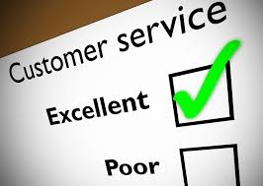
O&M of customer relations
The most important O&M activities for customer relations are:
  Have a clear line of contact for customers (customer phone line, or office desk)
  Solve customers’ complaints
  Reporting of customers complaints
  Keep the contracts up to date
  Formalise communication (letters, emails, phone, sms, visits if necessary)
  Analyse consumption and find the cause for large deviations
  Take care of special requirements of large customers
  Keep the list of customers up to date
  Disconnect and reconnect customers in a timely manner
  Making new connections on the existing system
  Check water tariffs
27
Notes:
27

