Slide 1
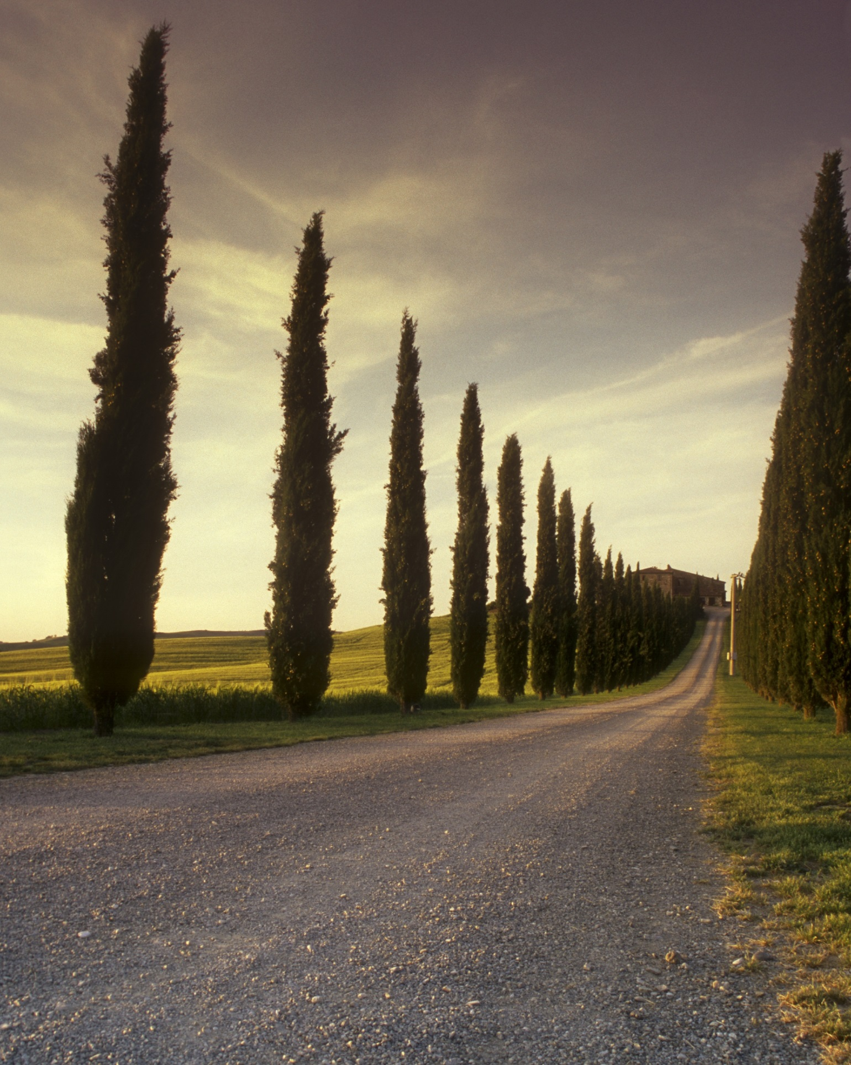
Becoming a Green Utility
Developed by
Funded by
Created under
http://bewop.un-ihe.org/
Part of the Green Utility Toolkit developed under BEWOP

Slide 2
Objectives of the Green Utility Tool
After this workshop, participants and their utility will have determined:
(i) What being a sustainable Green Utility means for them,
(ii) How they intend to measure its performance,
(iii) Where they envision their utility in the future, and
(iv) How they plan to get there.

Slide 3
Green Utility Tool Outline
Plan of action for a Green Utility
Bridge the gap: Green Utility Dimensions
Envision the future-state
Assess the current-state
Select indicators to measure sustainability
Translate definition to utility’s components
Define sustainability for water utility

Slide 4
Outline for the workshop
Activity | Schedule | Session
Introduction | TBD | 1
Step 1. Define sustainability | TBD | 1
Step 2. Translate definition | TBD | 1
Step 3. Select relevant indicators | TBD | 1
Recap | TBD | 2
Step 4. Assess the current-state | TBD | 2
Step 5. Envision the future-state | TBD | 2
Recap | TBD | 3
Step 6. Bridge the gap | TBD | 3
Step 7. Plan of Action for a Green Utility | TBD | 3
Notes:
Schedule is an example, change as required.

Slide 5
Define
Translate
Select
Defining Sustainability
Sustainability can be a very broad concept, what does it mean for you when considering your water utility?
Individually, pick the top 3 words that represent sustainability for you.
As a group, jointly define what top 5 words define sustainability.
Based on the chosen 5 words, as a group write a working definition for the concept of sustainability.
Notes:
If you are using the circle of priorities, at the end of the presentation there is an additional slide for this section

Slide 6
Define
Translate
Select
Defining Sustainability
Your Working Definition of Sustainability (Group 1)
Your Working Definition of Sustainability (Group 2)
Notes:
Adapt to the number of groups in the workshop. Refer back to this slide as needed, particularly while participants are undergoing Step 2.

Slide 7
Define
Translate
Select
Translating to components
Water Utility
Organizational
Financial
Operational
Technological
Political
Social
Institutional / Legal
Sectorial
Environmental
Others?

Slide 8
Define
Translate
Select
Translated components (part 1)
Component | Description
Organizational | Example: A utility that is organizationally sustainable has the capacity to administratively adapt to changes in its institutional environment, continuously supports the development of its staff in new approaches, and streamlines environmental considerations into its guiding principles.
Financial
Operational
Technological
Political

Slide 9
Define
Translate
Select
Translated components (part 2)
Pillars | Description
Environmental
Social
Institutional / Legal
Sectorial
Other:

Slide 10
Translate
Select
Assess
Selecting Relevant Indicators
Having defined how sustainability translates to your utility’s components, you will now choose how these should be measured by selecting relevant indicators.
A battery of indicators, with 20 different areas will be provided to you, in addition to your water utility’s existing relevant indicators.
In choosing your indicators, aim for them to be: Comprehensive, Applicable, Traceable, and Practical (based on Foxon et al. 2002)
INDICATOR | Unit of measurement
1. Example for Operational or Environmental: Physical (real) non-revenue water. | total, % over time
2. Example for Financial, Technological or Operational: Long-term plans for service expansion linked with foreseen population growth/change. | # of plans, periodicity of review, achieve-ment of targets

Slide 11
Select
Assess
Envision
Assessing utility’s current-state
Based on the indicators selected, you will score the current state of your utility with a letter “C”.
Take into account that you will need to define the Standard or Guideline based on which you are providing the score. These can be global, national, sector-related or internal.
IND. # | STANDARD / GUIDELINE | Very Low | Low | Med. | High | Very High
1 | Example: IWA Standards, World Bank, or local water sector guidelines. |  | C

Slide 12
Assess
Envision
Bridge
Envisioning the future-state
How far into the future are we envisioning our Green Utility?
Decide as a group what the time-frame for achieving your Green Utility will be.
It is useful to align this vision with relevant organizational, national, and/or international programmes: strategic plans, national development plans or the Sustainable Development Goals.
When looking into the future, what are some of the main constraints you can foresee in becoming a Green Utility?
Identify these constraints with your group:
CONSIDERED CONSTRAINTS
Example: Government development plans for next 10 years focus on promoting the industrial sector, so funds for expanding environmental approaches will be reduced.

Slide 13
Assess
Envision
Bridge
Envisioning the future-state
Using the scoring from the previous step, and considering your components and definition of sustainability, score with a letter “F” where your utility will be in the future.
IND. # | STANDARD / GUIDELINE | Very Low | Low | Med. | High | Very High
1 | Example: IWA Standards, World Bank, or local water sector guidelines. |  | C |  | F

Slide 14
Envision
Bridge
Plan of Action
Bridging the gap:
Dimensions of a Green Utility
To bridge the gap between your current- and future-state, you will define approaches based on the 3 Dimensions of a Green Utility.
Current practices
Pathways
Green 'turn-over'
Dimensions of a Green Utility:
Reflect on what WSP currently do.
Identify the WSP’s connections with its context/environment.
Explore new approaches that foster ‘green’ practices
Alignment with Water-Sensitive Cities 3 pillars of action
Notes:
For cities to achieve these aspects, WSC’s proposes three pillars of action. First, cities must be viewed as water catchments where diverse sources complement the existing supply through fit-for-purpose and alternative systems. Second, promote the recognition of urban ecosystem services that benefit the environment and the citizens. Third, foster empowered water-aware communities where water professionals and decision-makers work across a range of disciplines (re)shaping the existing institutional context.
Use this as an example in presentation: First = Green turn-over; Second = Current practices; Third = Pathways. The contributions of the water utility to WSC.

Slide 15
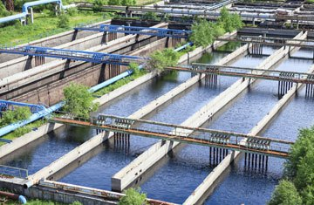
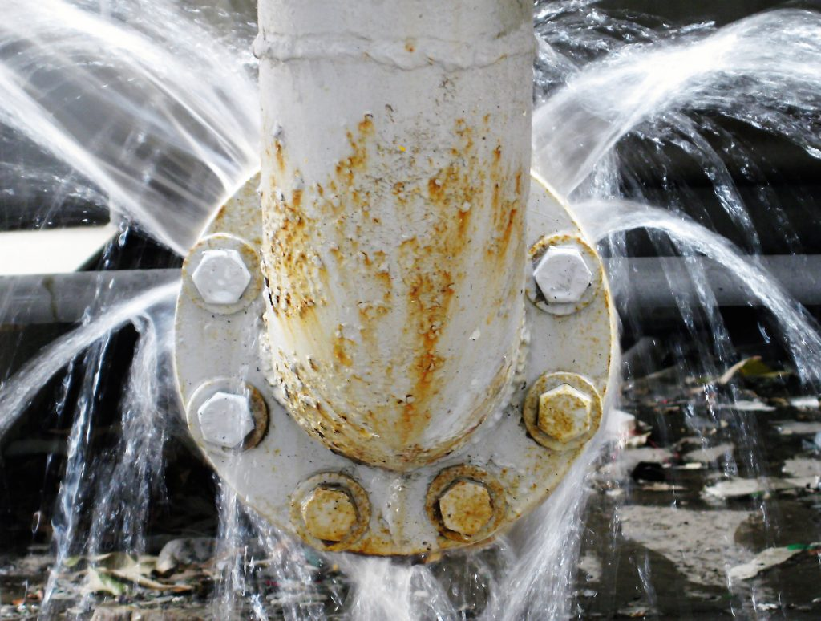
Envision
Bridge
Plan of Action
Current Practices
Process/infrastructure planning tool to consider environmentally-friendly alternatives or decentralization
Resource efficiency and water quantity/quality management
Awareness campaigns and eco-system services
Incorporate protection of natural environment
Asset Management →
Non-Revenue Water →
Customer Service →
Water Safety Plans →
Source: istockphotos
Source: IWA

Slide 16
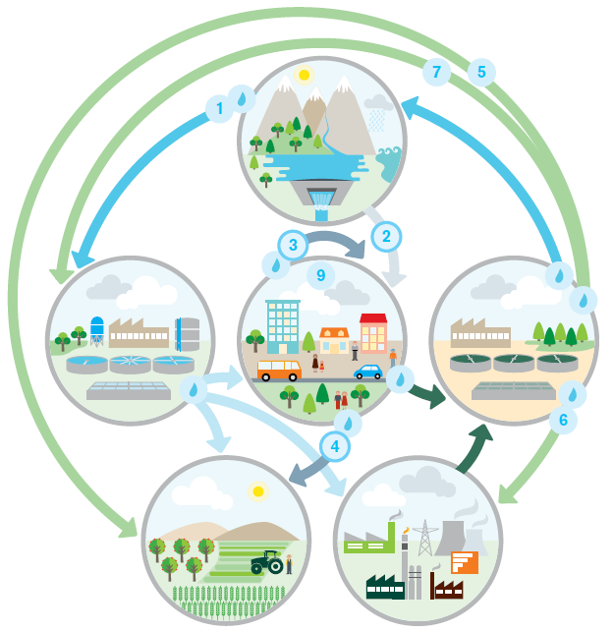
Envision
Bridge
Plan of Action
Pathways
Explicitly identify the flow(s) of water(s) and the pertinent stakeholders within this network.
Consider human and non-human actors, i.e. the environment is not a passive resource bank.
Consumer involvement.
Inter-sectorial synergies and approaches.
Source: IWA, 2016
Figure 4: Water Pathways – Source IWA (2016)

Slide 17
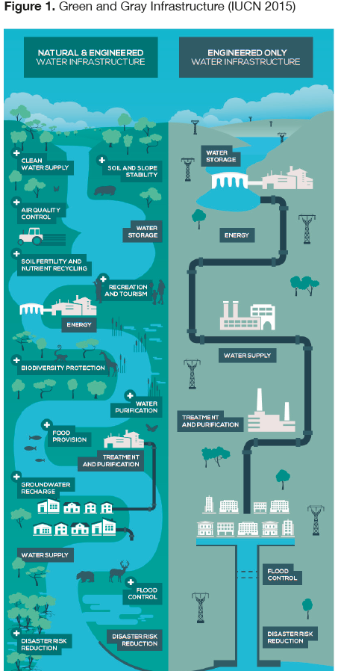
Green ‘turn-over’
Key decision-moments to radically shift towards sustainably-aligned processes:
Green-grey infrastructure investments
“Fit-for-purpose” and decentralized systems.
Resource Efficiency: energy and consumable alternatives
Accessing Green Funding alternatives
Envision
Bridge
Plan of Action
Source: IUCN

Slide 18
Envision
Bridge
Plan of Action
Dimensions of a Green Utility
In groups, decide which approaches or activities, related to each of the selected indicators, can support you in reaching your future-state Green Utility.
IND. # | CURRENT PRACTICES | PATHWAYS | GREEN TURN-OVER
1 | Example: NRW reduction will consider gains in reduction to source withdrawal; DMA’s focus on largest gains for environmental concerns. | Example: Liaison with consumers to support early detection of leakages. | Example: Retrofit higher-grade environmentally-conscious piping infrastructure.
Notes:
For cities to achieve these aspects, WSC’s proposes three pillars of action. First, cities must be viewed as water catchments where diverse sources complement the existing supply through fit-for-purpose and alternative systems. Second, promote the recognition of urban ecosystem services that benefit the environment and the citizens. Third, foster empowered water-aware communities where water professionals and decision-makers work across a range of disciplines (re)shaping the existing institutional context.
Use this as an example in presentation: First = Green turn-over; Second = Current practices; Third = Pathways. The contributions of the water utility to WSC.

Slide 19
Envision
Bridge
Plan of Action
Planning for a Green Utility
In this last step, as a group, you will choose from the defined approaches and activities, those that are deemed most effective and feasible.
This action plan will provide you with a tangible way forward to reach your envisioned Green Utility.
Activity / Approach | Time-frame |  |  | Estimated Invest-ment Cost | Potential Source of funding | Respon-sible(s)
 | Quick-win | Mid-term | Long-term
Example: Liaison with consumers to support early detection of leakages. | X |  |  | $ | Internal | Costumer Service

Slide 20
Becoming a Green Utility
Developed by
Funded by
Created under
http://bewop.un-ihe.org/
Part of the Green Utility Toolkit developed under BEWOP

Slide 21
Additional Slides for support
based on the topics covered
in the GU Concept Note

Slide 22
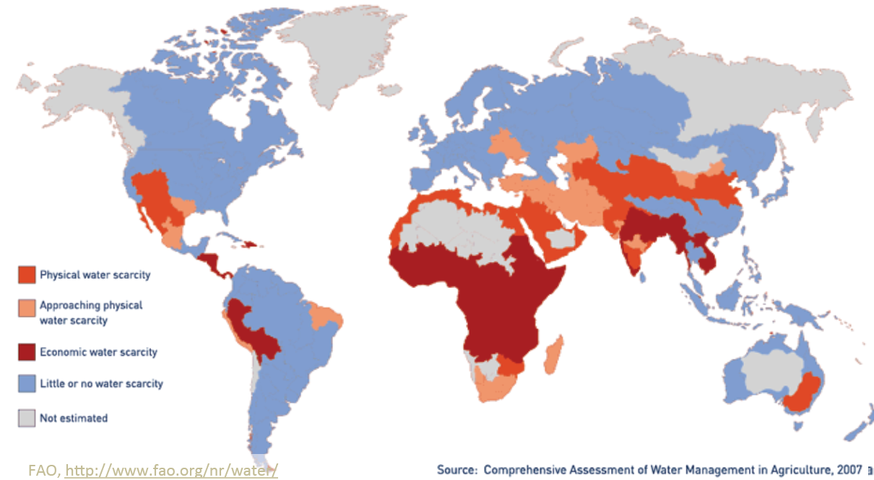
Driving Factors Compiled
Notes:
Water scarcity, Climate change, Urban Population Growth (growing population and urbanization trends), and SDGs

Slide 23
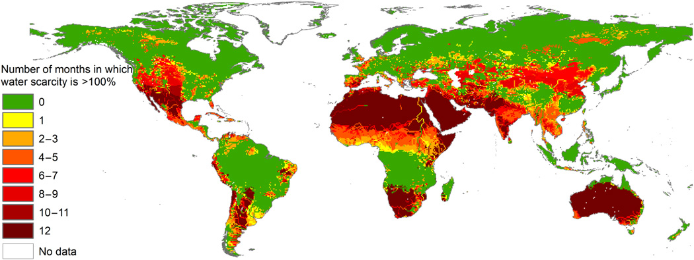
Driving Factors: Water Scarcity
Source: Mekonnen, M. and Hoekstra, A., 2016

Slide 24
Driving Factors: Climate Change

Slide 25
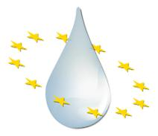
Driving Factors: (Inter)national Commitments

Slide 26
Driving Factors:
Urban Growth

Slide 27
Driving Factors: Urbanization

Slide 28
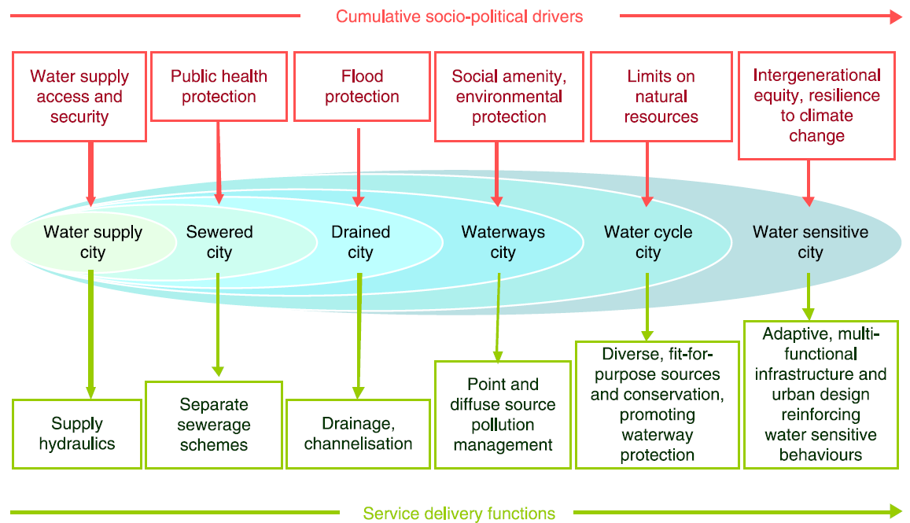
Historical Development and the ‘Hydro-social contract’
Urban Water Management transitions framework, Source: Brown, 2009
Notes:
1. The hydro-social contract implicitly promised the delivery of a safe, cheap and largely limitless volume of water from a benign environment to the
rapidly growing urban population.
2. The hydro-social contract implicitly promised public health protection to the rapidly growing urban population, through the delivery of sewerage services directing waste flows to an environmentally benign receiving waterway environment.
3. the hydro-social contract implicitly promised cost-effective flood protection services through the efficient conveyance of stormwater to a benign waterway environment to facilitate the rapid urban expansion of cities. Transition to a more complex hydro-social contract involving multiple (and fragmented) urban water services providers.
4. ‘Old’ hydro-social construct and environmentalism 1960-70s, inclusiveness.
5. SUWM/IUWM diffuse new hydro-social contract.
6. Ideal, sustainability long-term, over-haul of hydro-social contract.

Slide 29
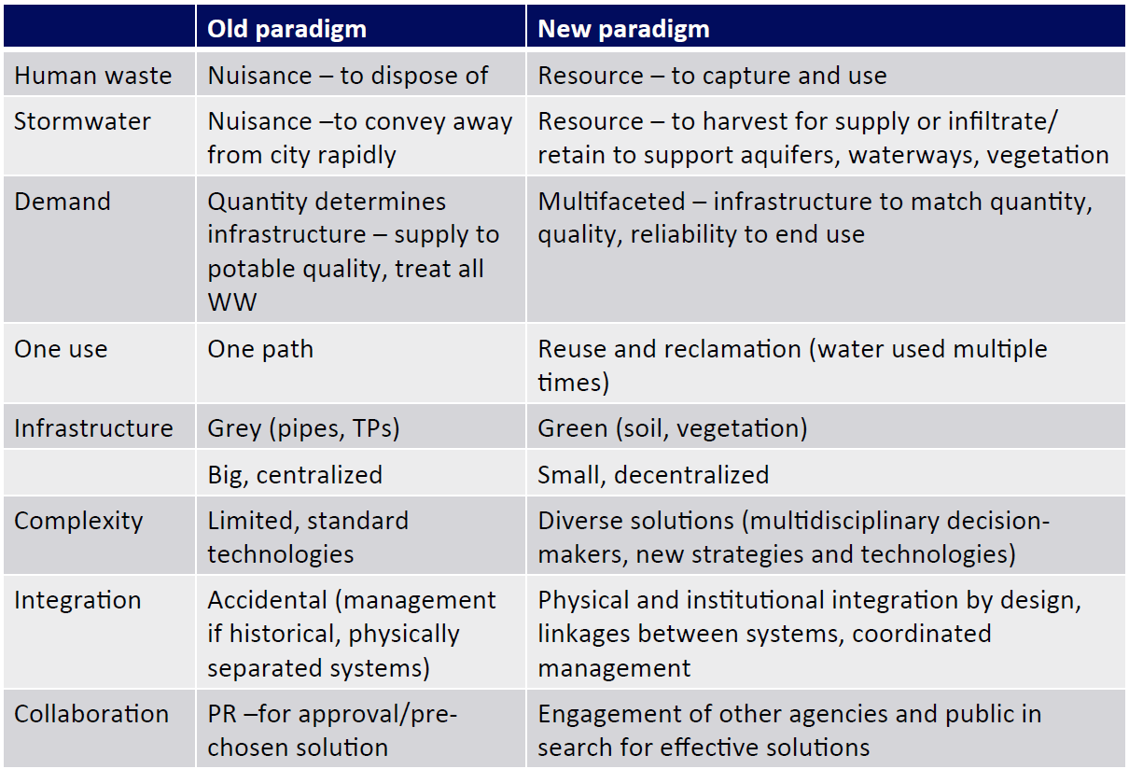
Current approaches: Integrated Urban Water Management
Source: Mitchell, 2006
Notes:
The principles of IUWM can be
summarized as follows:
1. Consider all parts of the water cycle, natural and constructed, surface and subsurface, recognizing them as an integrated system.
2. Consider all requirements for water, both anthropogenic and ecological.
3. Consider the local context, accounting for environmental, social, cultural, and economic perspectives.
4. Include all stakeholders in planning and decision-making processes.
5. Strive for sustainability, aiming to balance environmental, social, and economic needs in the short, medium, and long term.

Slide 30
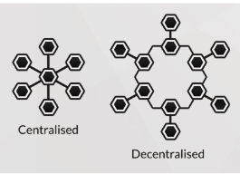
Current approaches: Sustainable Urban Water Management
Centralized → Decentralized
A more ‘natural’ water cycle
Diversification of sources through ‘fit-for-purpose’
Resource efficiency
Source: Reddit
https://www.youtube.com/watch?v=HymGr5gyiB4

Slide 31
Current Approaches: Water Sensitive City
https://www.youtube.com/watch?v=v0fX6L_zrBo

Slide 32
Current Approaches Shared Aims
Integration of Urban Water Cycle
‘Fit-for-purpose’ water use and design.
Active stakeholder involvement in decision-making, no longer passive consumer.
Sustainability focus based on balancing social, economic, and environmental needs at varying timescales.
Integrated Urban Water Management (IUWM)
Sustainable Urban Water Management (SUWM)
Water Sensitive City (WSC)
Notes:
WSC CRC https://www.youtube.com/watch?v=v0fX6L_zrBo

Slide 33
UWM Paradigms and Water Utilities
UWM Paradigms common goal:
to cover the water demand of current and future consumers through effectively engaging an integral water cycle, while considering the health and protection of the surrounding environment
UWM Paradigms overarching approaches to achieve this goal:
actively engaging and improving the efficiency of the various water flows throughout the city, and
by stressing the importance of engaging with a broader range of stakeholders, including the end-user of the water system(s).
How can your water utility contribute?

Slide 34
Benefits of adopting UWM Paradigm approaches
A more ‘natural’ water cycle, and hence a more environmentally-sound flow of water.
Increased water security through local source diversification..
Greater efficiency through fit-for-purpose water use.
A broader approach to water systems’ sustainability through awareness of customers’ values and needs, enhancing socially aligned long-term plans and investments.
The uptake of decentralized systems allows for more ‘radical’ innovation which may lead to higher efficiency, improved community well-being, and source protection.
What potential approaches can your utility implement
based on these benefits?

Slide 35
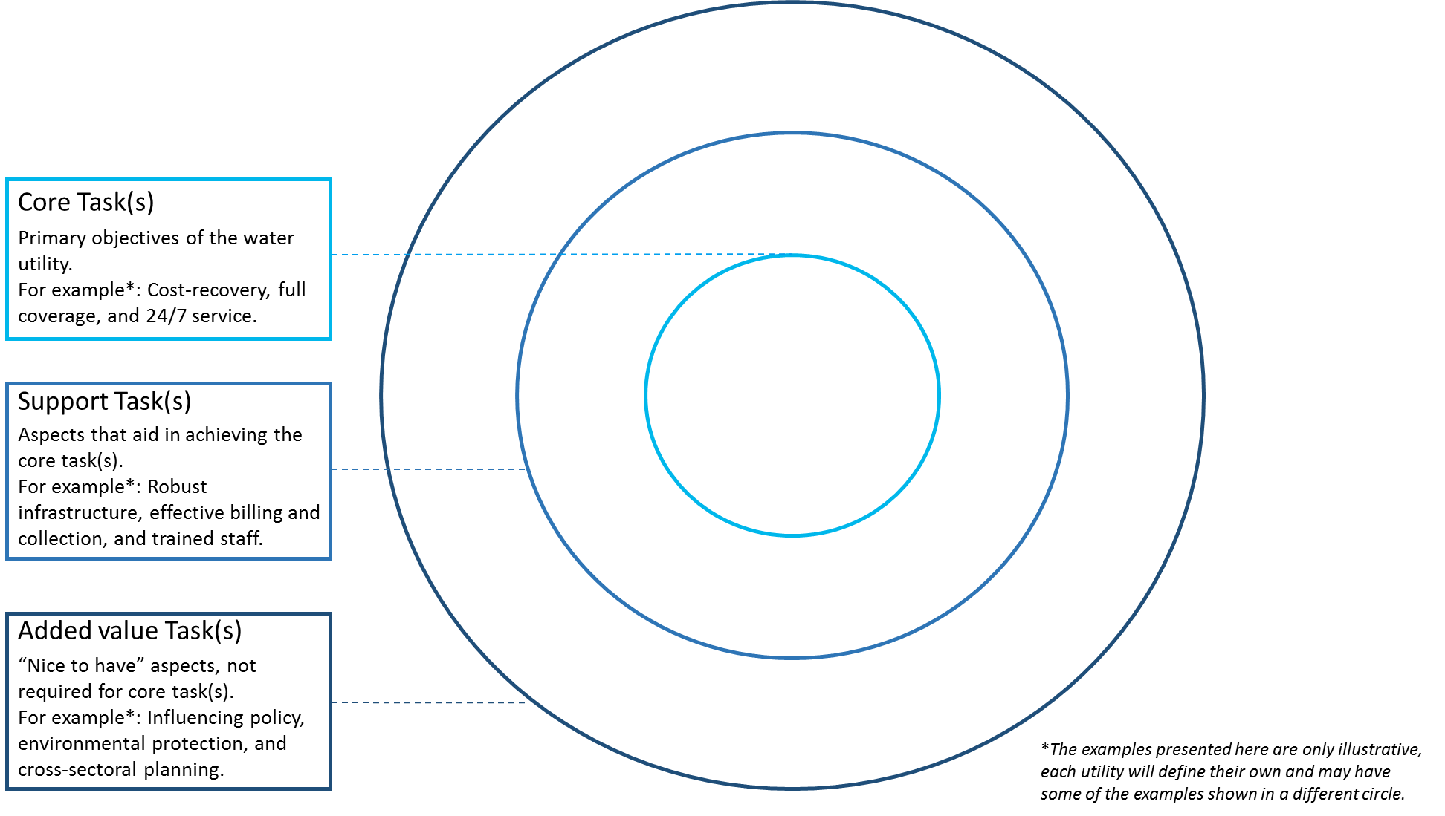
Circles of (Green) Development

Slide 36
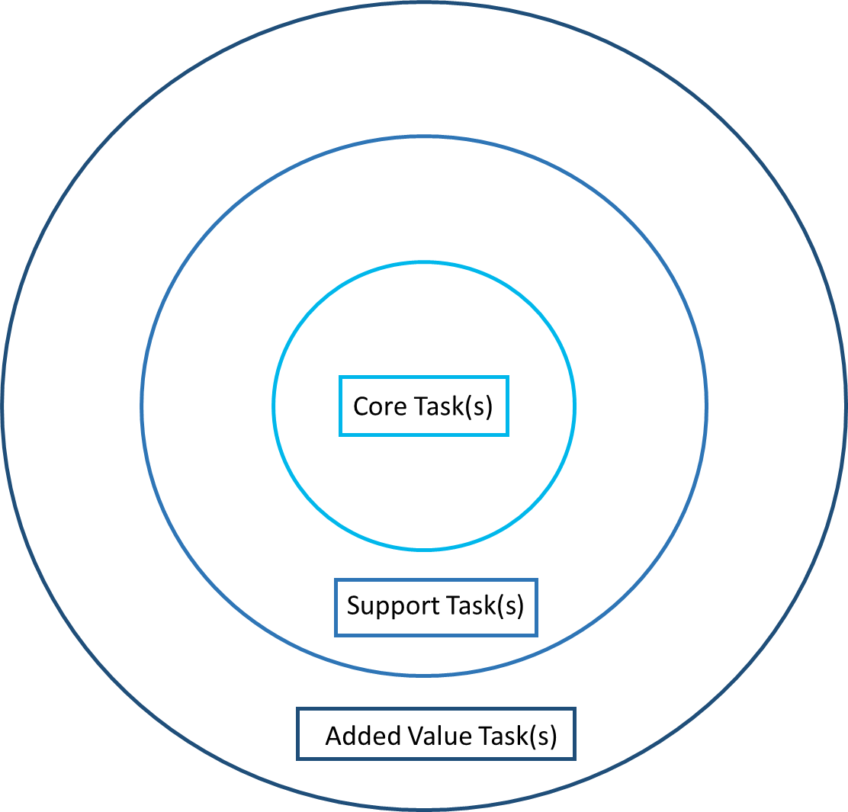
Define
Translate
Select
Defining Sustainability
Sustainability can be a very broad concept, what does it mean for you when considering your water utility?
Based on your Circle of Green Priorities, as a group select the level which you want to foster sustainability.
For that level, individually write 3 words that describe sustainability at the selected level.
As a group, jointly define what top 5 words define sustainability.
Based on the chosen 5 words, as a group write a working definition for the concept of sustainability.
Notes:
If you are using the circle of priorities, at the end of the presentation there is an additional slide for this section

Slide 37
The stages of a Green Utility
Mature
Green Utility
Emerging
Green Utility
Streamlined into strategic plans and processes
Projects allotted sufficient internal funds
Larger external funds from diverse sources
Research and environmental organizations engaged
Champions in various departments
Sector leaders
Early Green Utility
Gaining internal support
Projects mainly depend on external funding
Local gov’t and consumers engaged
Designated staff member or department
Not a priority
Fulfilment of external requirements
Limited SH engaged
No internal unit
Where are you now?

Slide 38
Challenges and Opportunities for a Green Utility
Source: Imperial College London
Source: CFD Trading
Source: Community Dream Builders
Notes:
Longer financial horizons / cost-savings / Diverse sources of funding
Community support / engagement
More options

Slide 39
Define
Translate
Select
Translating to components
Based on your definition of sustainability, describe in groups how each component should be defined in order to be considered as sustainable.
You can take into consideration that the main objectives of sustainable water systems, which according to Hellström 2000 (p312) are:
moving towards a nontoxic environment;
improving health and hygiene;
saving human resources;
conserving natural resources;
saving financial resources.
As such, sustainable systems should:
have a high degree of functional robustness and flexibility,
be adapted to local conditions, and
be easy to understand and thus encourage responsible behaviour by the users.

