Slide 1


Introduction to NRW
Introduction to IWA Water Balance, NRW components and Performance indicators

Slide 2
Content
IWA Water Balance
NRW components
NRW Target Level
Summary

Slide 3
IWA Water Balance

Slide 4
What is Non-Revenue Water (NRW)?
NRW is the volume of water supplied into the network that does not generate sales revenue
$
Revenue
$
Non-Revenue Water
X

Slide 5
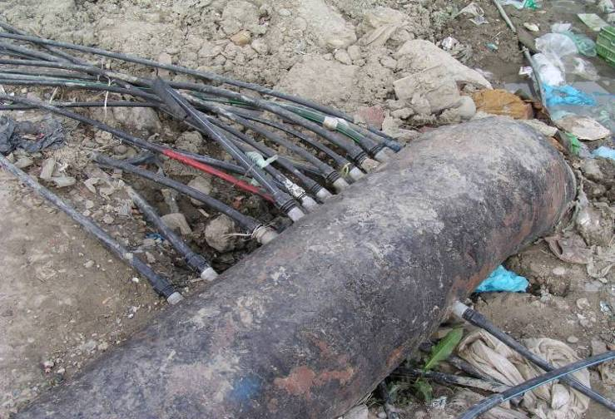
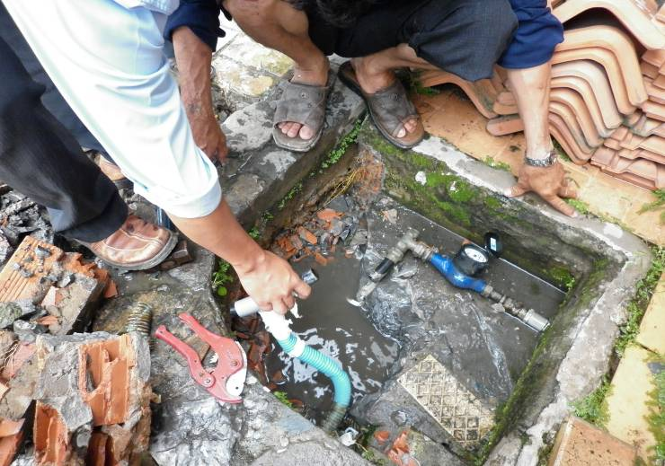
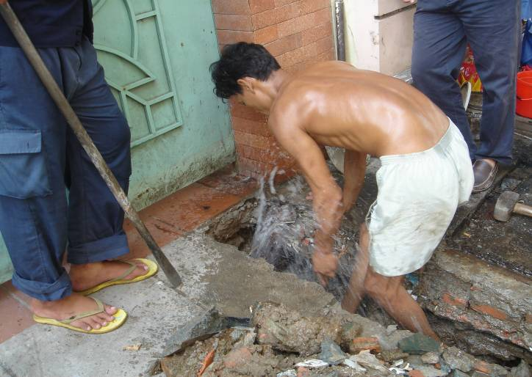
Non-Revenue Water
Illegal connections
Apparent Losses
Meter inaccuracy
Real losses
Notes:
5

Slide 6
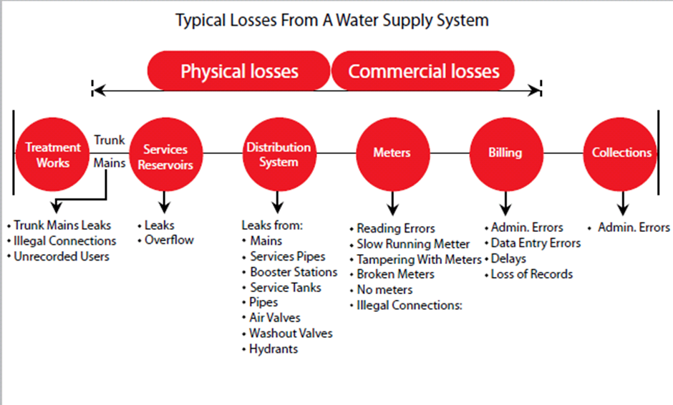
Typical losses from a water supply system
Notes:
6

Slide 7


IWA Water balance
Total System Input Volume | Authorised consumption | Billed authorised consumption | Billed metered consumption | Revenue water
 |  |  | Billed unmetered consumption
 |  | Unbilled authorised consumption | Unbilled metered consumption | Non-revenue water
 |  |  | Unbilled unmetered consumption
 | Water losses (Unaccounted-For Water) | Apparent losses (Commercial losses) | Unauthorised consumption
 |  |  | Metering inaccuracies and data errors
 |  | Real losses (Physical losses) | Leakage in transmission and distribution lines
 |  |  | Leakage and overflows at storage tanks
 |  |  | Leakage on service connections up to customer meters
2 oktober 2018
7
Notes:
7

Slide 8
IWA Water balance
Taking into account the billing and collection efficiency
Total System Input Volume | Authorised consumption | Billed authorised consumption | Paid billed metered consumption | Revenue water
 |  |  | Paid billed unmetered consumption
 |  |  | Unpaid billed metered consumption | Non-revenue water
 |  |  | Unpaid billed unmetered consumption
 |  | Unbilled authorised consumption | Unbilled metered consumption
 |  |  | Unbilled unmetered consumption
 | Water losses (UFW) | Apparent losses (Commercial losses) | Unauthorised consumption
 |  |  | Metering inaccuracies and data errors
 |  | Real losses (Physical losses) | Leakage in transmission and distribution lines
 |  |  | Leakage and overflows at storage tanks
 |  |  | Leakage on service connections
2 oktober 2018
8
Notes:
8

Slide 9
Non-Revenue Water Metaphor
A quote of a concerned Managing Director:
“Non-Revenue Water is like a disease. There are tons of known medicine (NRW reduction approaches) for our disease called NRW and we have tried to applied some medicine. However it seems that tried medicine is not curing our disease. The trials of using the medicine had cost us a lot of effort, money and hope. Therefore, before trying to apply a new medicine we need to first analyse our disease, only then we can know which medicines we need to apply to cure our disease, before our companies dies of the NRW”.

Slide 10
NRW Components

Slide 11
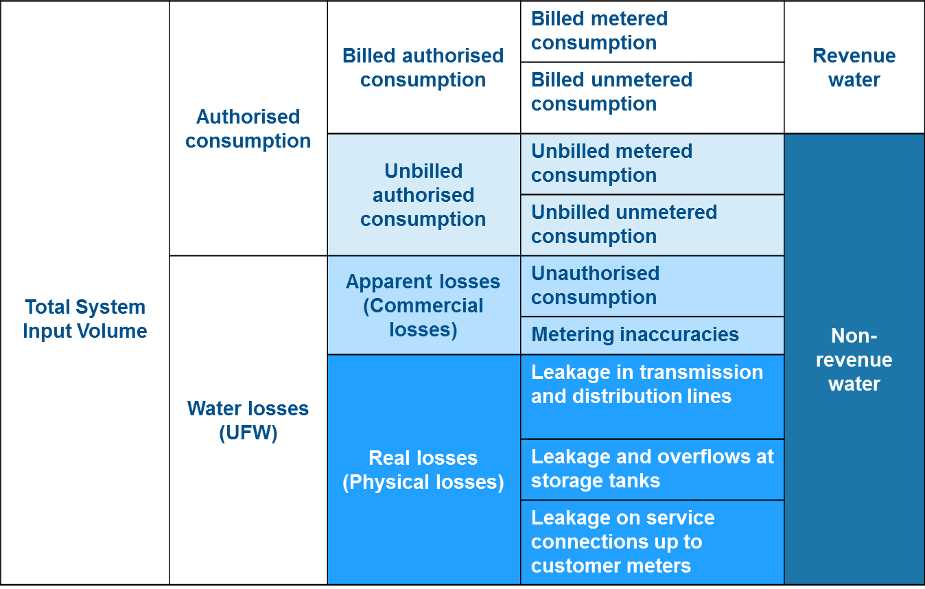
NRW Components in Each DMA
To allow for prioritisation of efforts to reduce NRW one needs to calculate/estimate the DMA’s water balance components
Using available data and experience, and extra on-site measurements, one can calculate/estimate the:
  Unbilled Authorised Consumption
  Commercial (apparent) loss components , and
  Physical (real) loss components
  Billing-Collection efficiency
Nrw components
11

Slide 12
NRW Components in Each DMA
Reducing commercial losses directly generates revenue for the water company
Reducing physical losses:
  Reduces the cost of producing the water (less water needed, less chemical and energy use)
  Improves customer service (more pressure, less supply interruptions and less contamination)
Furthermore, improving the billing-collection efficiency will also improve the water utilities’ revenue
How would you prioritise NRW reduction?

Slide 13
Unbilled Authorised Consumption

Slide 14
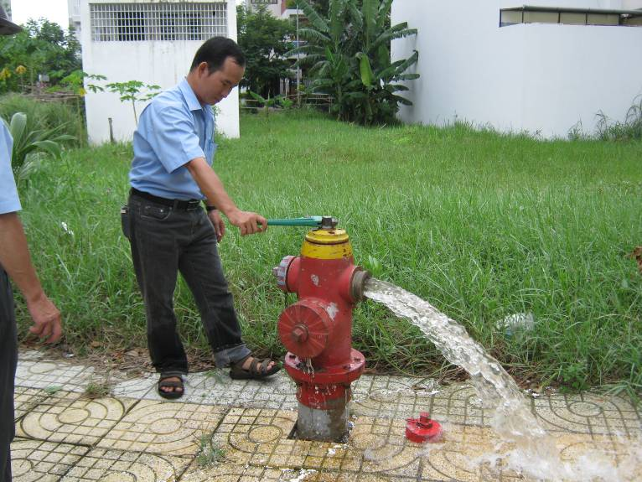
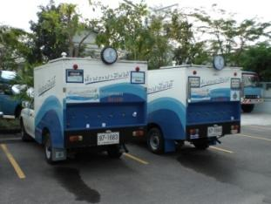
Unbilled Authorised Consumption
What is Unbilled Authorised Consumption?
Water legitimately consumed but not billed
Cannot be reduced unless there is a change in policy
Still should be metered as part of the water balance
This can be:
  Water fountains
  Pipe and sewer flushing
  Watering parks and gardens / sprinklers
  Public drinking fountains
  Fire fighting – e.g. hydrants

Slide 15
Commercial Losses

Slide 16
Key Components of Commercial Loss
Unauthorised Consumption | Legitimate connections that were never entered into the billing system and are therefore never invoiced (intentional and accidental) Permanent or temporary meter bypass Illegal connections Illegal use of fire hydrants
Meter Inaccuracies | Volume under-recorded by revenue meter due to its condition Over-sized revenue meters Meter tampering (water theft)
Meter Reading Errors | Corruption meter readers (collusion with customers) Meter reading errors (mistakes, or unreadable meters)
Accounting Errors | Data handling errors billing department Bills sent to wrong address

Slide 17
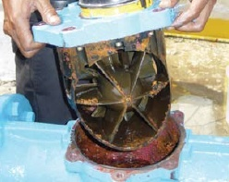
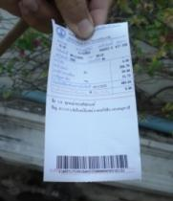
Four Approaches to Commercial Loss Reduction
Prioritise your Commercial Loss Approach
Meter maintenance
Improve billing database
Commercial Loss Reduction
Meter reader awareness and training
Customer and local agencies’ awareness

Slide 18
Physical Losses (leakage)

Slide 19
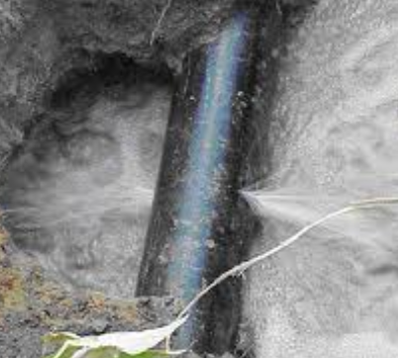
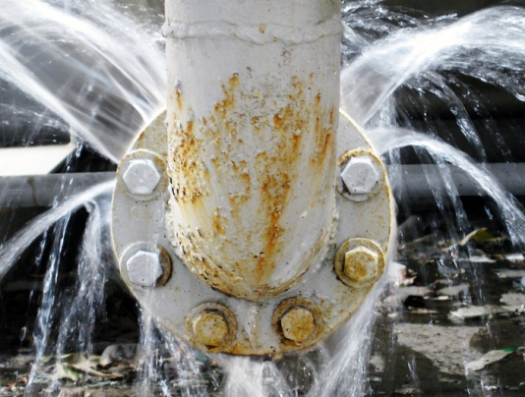
Physical Losses (leakage)
Leakage is the water escaping from the distribution network before reaching the customer
This is usually in the form of leaks from the:
Transfer and distribution pipes;
Joints and fittings including air valves, hydrants etc;
Service reservoir/storage tank floors and walls and overflows;
Service connections up to the point of customer boundary or meter

Slide 20
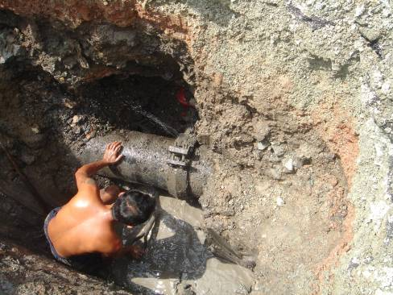
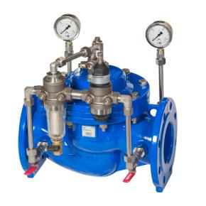
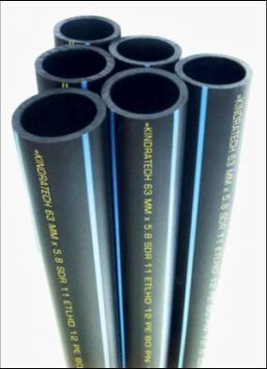
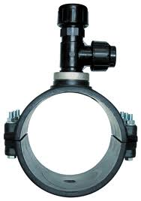
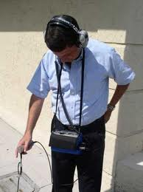
Four Approaches to Leak Reduction
Prioritise your Leak Reduction Approach
Pressure Management
Leakage Reduction
Speed and Quality of Repairs
Active Leakage Control
Pipe materials, installation, replacement and maintenance

Slide 21
NRW Target Level

Slide 22
Target: Economic Level of Leakage
The Economic Level of Leakage (ELL) is ‘the level of leakage at which any further reduction would incur costs greater than the benefits derived from the savings’
In theory, the ELL would serve as the water company’s leakage level target
In practice, it is extremely difficult and time consuming to calculate the ELL; it is specific to each water company and even to each DMA
Consequently, best international practice for leakage target setting uses the easier performance indicators of:
  Infrastructure Leakage Index (ILI); and
  Volume of Leakage per Service Connection per Day
Calculating these leak performance indictors enables DMAs to be prioritised for proactive leak reduction activities

Slide 23
Method 1 - Infrastructure Leakage Index
Referred to as CAPL – Current Annual Volume of Physical Losses
Infrastructure Leakage Index (ILI) is the ratio of:
It is the international indicator for water network efficiency
An ILI of 4 is comparable with an efficient water company
It can also be used to compare leakage performance across DMAs
Actual Leakage
-----------------------------------------------------------
Minimum Achievable Leakage
Infrastructure Leakage Index =
Referred to as MAAPL – Minimum Achievable Annual Physical Losses
‘Minimum Achievable Annual Physical Losses’ is calculated by:
MAAPL (litres/day) = (18 x Lm + 0.8 x Nc + 25 x Lp) x P
Where Lm = mains length (km); Nc = number of service connections; Lp = total length of private pipe, property boundary to customer meter (km); and P = average pressure (m)

Slide 24
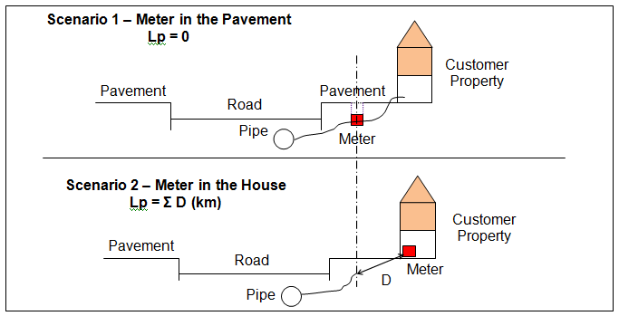
Measuring Customer Supply Pipe length
Lp is the sum of the pipe lengths from the property boundary to the customer meter
Estimate the average distance of pipe on customer property ‘D’ for the DMA

Slide 25
Method 1 - Infrastructure Leakage Index
Example calculation for Minimum Achievable Leakage of a DMA:
DMA Data | Value | Units
Total length of pipe (Lm) | 4.81 | Km
Number of connections (Nc) | 1,196 | Number
Total Service connection length (Lp) | 3.6 (average D=3m) | Km
Average DMA pressure | 11.7 | Metre
Minimum Achievable Annual Volume of Physical Losses | 13.2* | m³ / day
*Minimum Achievable Leakage for DMA =
((18x 4.81 x11.7) + (0.8 x 1,196 x 11.7) + (25 x 3.6 x 11.7))/1000 = 13.2 m³/day
MAAPL (litres/day) = (18 x Lm + 0.8 x Nc + 25 x Lp) x P

Slide 26
Method 1 - Infrastructure Leakage Index
Evaluating the Infrastructure Leakage Index
ILI Range | Band | Leakage Reduction
< 4 | A | Further loss reduction may be uneconomical
4 to < 8 | B | Lower priority
8 to < 16 | C | Medium Priority
≥ 16 | D | High Priority
Actual Leakage
----------------------
Minimum Achievable Leakage
Infrastructure Leakage Index =

Slide 27
Method 1 - Infrastructure Leakage Index
Example evaluation Infrastructure Leakage Index
 | DMA 1 | DMA 2 | DMA 3 | DMA 4 | DMA 5 | DMA 6
Actual Leakage | 776 | 180 | 51 | 92 | 400 | 210
Minimum Possible Leakage | 13.2 | 14.9 | 17.1 | 16.4 | 11.4 | 14.6
ILI | 59 | 12 | 3 | 6 | 35 | 14
Category | D | C | A | B | D | C
ILI Range | Band | Leakage Reduction
< 4 | A | Further loss reduction may be uneconomical
4 to < 8 | B | Lower priority
8 to < 16 | C | Medium Priority
≥ 16 | D | High Priority

Slide 28
Leakage Target Setting Using ILI
 | DMA 1 | DMA 2 | DMA 3 | DMA 4 | DMA 5 | DMA 6
Actual Leakage | 776 | 180 | 51 | 92 | 400 | 210
Leak Reduction Volume | 700 | 90 | 0 | 0 | 330 | 120
Target leakage (m³/day) | 76 | 90 | 51 | 92 | 70 | 90
Minimum Possible Leakage | 13.2 | 14.9 | 17.1 | 16.4 | 11.4 | 14.6
ILI | 6 | 6 | 3 | 6 | 6 | 6
Category | B | B | A | B | B | B
ILI Range | Band | Leakage Reduction
< 4 | A | Further loss reduction may be uneconomical
4 to < 8 | B | Lower priority
8 to < 16 | C | Medium Priority
≥ 16 | D | High Priority

Slide 29
Method 2 – Leakage/Connection/Day
Evaluating the Leakage / Connection / Day
Misleading and imprecise indicator, particularly in systems with intermittent supply and very low operating pressures. Utilities with a lower percentage of NRW might be doing worse than a utility with a higher percentage of NRW. % may be used when comparing changes within one area when ‘outside factors’ (average supply time, pressure) do not change
%
m³/connection/day
Water Volume not Sold
Water Volume Produced
Water Volume not Sold/24h* supply
# connections
This unit IWA has set as the international standard performance indicator for NRW
* With intermittent supply, the daily volume lost has to be extrapolated. I.e. with 17 hours supply, multiply by 24/17

Slide 30
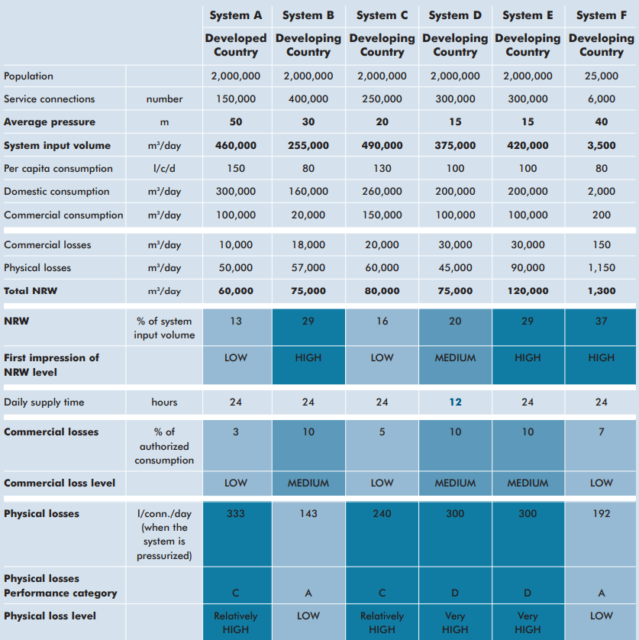
Method 2 – Leakage/Connection/Day
Source: Water Supply and Sanitation Sector Board Discussion Paper Series, Paper No. 8, December 2006

Slide 31
Method 2 – Leakage/Connection/Day
International NRW Assessment
Calculate NRW in m3/connection/day
Reference the performance category using the average DMA pressure
NRW Management Performance Category | NRW in litres/connection/day when the system is pressurised at an average DMA pressure of:
 | 10m | 20m | 30m | 40m | 50m
A1 | <55 | <80 | <105 | <130 | <155
A2 | 55-110 | 80-160 | 105-210 | 130-260 | 155-310
B | 110-220 | 160-320 | 210-420 | 260-520 | 310-620
C | 220-400 | 320-600 | 420-800 | 520-1000 | 620-1200
D | >400 | >600 | >800 | >1000 | >1200

Slide 32
Method 2 – Leakage/Connection/Day
A1: World class NRW management performance; potential for further NRW reductions is small unless there is potential for pressure reduction or accuracy improvement of large customer meters
A2: Further NRW reduction may be uneconomic unless there are water shortages or very high water tariffs; a detailed water audit is required to identify cost-effective improvements
B: Potential for marked improvements; establish a water balance to quantify the components of NRW; consider pressure management, better active leakage control practices, and better network maintenance; improve customer meter management, review meter reading, data handling and billing processed and identify improvement potentials
C: Poor NRW record; tolerable only if water is plentiful and cheap; even then, analyze level and causes of NRW and intensify NRW reduction efforts
D: Highly inefficient; a comprehensive NRW reduction program is imperative and high-priority *Example at 10m pressure
 | DMA 1 | DMA 2 | DMA 3 | DMA 4 | DMA 5 | DMA 6
Actual Leakage | 776 | 180 | 51 | 92 | 400 | 210
# of Connections | 1,196 | 1,515 | 1,603 | 1,652 | 1,298 | 1,573
Leakage / connection | 648 | 119 | 32 | 56 | 308 | 133
Category* | D | B | A1 | A2 | C | B

Slide 33
Method 2 - Leakage Target Setting Using L/C/D and Pressure
 | DMA 1 | DMA 2 | DMA 3 | DMA 4 | DMA 5 | DMA 6
Actual leakage | 776 | 180 | 51 | 92 | 400 | 210
Number of connections | 1,196 | 1,515 | 1,603 | 1,652 | 1,298 | 1,573
Target leakage (m³/day) | 700 | 90 | 0 | 0 | 334 | 117
Leakage after project | 76 | 90 | 51 | 92 | 66 | 93
Leakage / connection | 63 | 59 | 32 | 56 | 51 | 59
Category | A2 | A2 | A1 | A2 | A2 | A2
NRW Management Performance Category | NRW in litres/connection/day when the system is pressurised at an average DMA pressure of:
 | 10m | 20m | 30m | 40m | 50m
A1 | <55 | <80 | <105 | <130 | <155
A2 | 55-110 | 80-160 | 105-210 | 130-260 | 155-310
B | 110-220 | 160-320 | 210-420 | 260-520 | 310-620
C | 220-400 | 320-600 | 420-800 | 520-1000 | 620-1200
D | >400 | >600 | >800 | >1000 | >1200

Slide 34
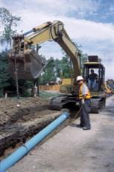
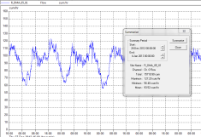
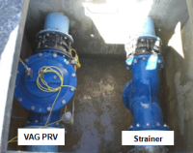
Summary
NRW is a waste of money
Reducing Commercial Losses generates revenue
Reducing Physical Losses reduces the costs of producing the water (chemical and energy reduction)
NRW is a puzzle: analyse and prioritise the approach
Infrastructure Leakage Index (ILI) and Volume of Leakage per Service Connection per Day are international performance indicators of NRW (not %!)

