Slide 1
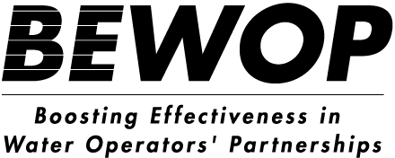
Operations and Maintenance
Curative and preventive maintenance

Slide 2
Content
Introduction to O&M
Curative Maintenance
Preventive Maintenance
O&M for Customer Relations

Slide 3
Introduction to O&M

Slide 4
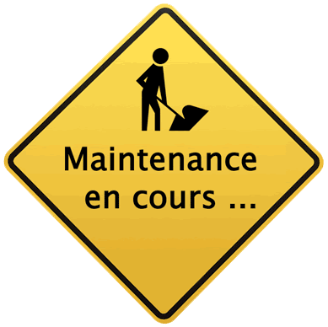
Importance of operation and maintenance
Operation and maintenance comprises all planned and unplanned activities that are necessary to secure the current and future functionality of the distribution network and other assets
The most important objectives of O&M are:
Maintain the quality/functionality of the distribution network and assets
Extend the lifetime of the distribution network and assets
Reduce disturbance of the network and assets
Minimise costs
Minimise Non-Revenue Water (NRW)
Improve the service level for the clients
Quality of water
4
Notes:
4

Slide 5
Maintenance approaches
Maintenance can be undertaken curatively or preventively
Curative maintenance, or corrective maintenance comprises all activities undertaken to solve malfunctions in the distribution network. Examples of curative maintenance are:
Repair leaking valves
Replace a mal-functioning valve
Repair leaking fire hydrant
Repair leakage in a pipeline
Repair leakage at a house connection
Replacing faulty (customer or district) meters
Preventive maintenance, or corrective maintenance comprises all activities undertaken to prevent malfunctions and/ or to extend the life of the assets. Examples of preventative maintenance are:
Checking the accessibility and functioning of valves
Checking the soil coverage of the network (normally done during leak repairs or other maintenance on the network)
Cleaning out filters (before they block)
Calibrating meters
5
Notes:
5

Slide 6
Necessities for maintenance activities
Planning team
Planning tools, such as software, registration forms
Inspection teams that do all controls/inspections within the designated area
Inspection team might implement ad-hoc solutions
Tools such as maps, GPS, walky talky, registration forms
Transport
Maintenance teams that make for major repairs
Tools such as maps, registration forms, repair tools and spare parts
Transport
Contractor (optional) for specifically large works
Ensure enough stock of tools and materials is available at all times!
6
Notes:
6

Slide 7
2. Curative Maintenance

Slide 8
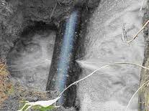
General guidelines
Curative maintenance, or corrective maintenance comprises all activities undertaken to solve malfunctions in the distribution network. The most common failures are pipe bursts, broken appendages or mal-functioning appendages
General guidelines for curative maintenance:
Planning and execution of curative maintenance is based per asset on the maintenance manual; materials for repairs and replacements are standardised
Emergencies like pipe burst have to be solved straight away
Some failures, such as smaller leakages, can be quickly solved temporarily. Proper repair with standard materials must be planned as soon as possible
If an appendage is broken, the degree of wear must be determined in order to decide whether it needs to be repaired or replaced (based on cost/risk analysis)
8
Notes:
8

Slide 9
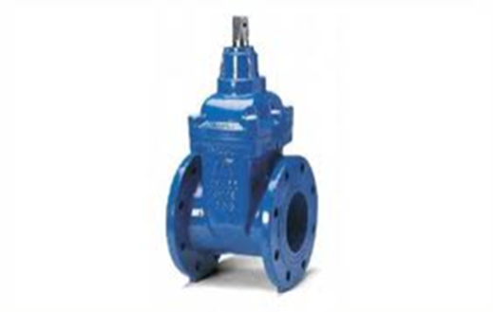
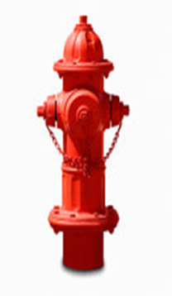
Curative maintenance
Guidelines for curative maintenance of appendages:
All repairs and replacements of failing appendages need to be carried out with standard materials
If an appendage is broken, the degree of wear must be determined in order to decide whether it needs to be repaired or replaced. Replacement is necessary when repairing is not possible or more costly than repair
Repair of appendages often is cheaper than replacement. For instance the repair of a leaking seal by replacing the seal. Before repair always contact the supplier for availability of spare parts if the spare parts are not in stock
The asset manager or caretaker decides whether to use spare parts or buy a new appendage.
9
Notes:
9

Slide 10
Curative maintenance: Appendages
Guidelines for curative maintenance of appendages:
All repairs and replacements of failing appendages need to be carried out with standard materials
If an appendage is broken, the degree of wear must be determined in order to decide whether it needs to be repaired or replaced.
Replacement is necessary when repairing is not possible or more costly than repair
Repair of appendages often is cheaper than replacement. For instance the repair of a leaking seal by replacing the seal. Before repair always contact the supplier for availability of spare parts if the spare parts are not in stock
The asset manager or caretaker decides whether to use spare parts or buy a new appendage.
10
Notes:
10

Slide 11
Curative maintenance: pipelines
Guidelines for curative maintenance of pipelines:
Repairs of leakages are carried out with standard materials. This means that the warehouse must have all the necessary materials in stock
The internal diameter of materials used for repair must be the same as the ones from the existing pipelines
If it is not possible to install materials with the same diameter, the diameter of the replaced material must be as close as possible to the original. For example when PE-pipes are replaced by PVC-pipes. Changes in material or diameters must be registered and implemented in all databases and software (f.e. GIS and hydrological model).
Repair or replacement of damaged pipelines must be done as soon as possible to minimize the damage to the surrounding area and to minimize the loss water.
11
Notes:
11

Slide 12
Curative maintenance: PVC pipes
Guidelines for curative maintenance of PVC pipes:
In case a part of a PVC pipe is replaced the diameter and pressure class from the existing and the new pipe must be the same
The connections between the existing and new pipe can be made with the use of a socket of galvanized iron and a socket of PVC. The iron socket (and the PVC socket; PVC socket first ???) must be pushed completely over the existing PVC pipe. After the new part of PVC pipe is in place, with the use of the PVC socket, the iron socket can be pushed back partly over the existing and partly over the new pipe. With this method the new pipe can be installed without digging up big lengths of the existing pipe
It is also possible to repair with two PVC sockets. Use two additional pieces of pipe. Put both sockets on a piece of PVC pipe. Put the two pieces with sockets on both ends of the existing pipe and push the sockets over the new pipe until the pieces of additional pipe fall out. By doing this the sealing rings of the sockets do not damage. Now place the new pipe between the two existing pipe ends, mark the distance of half the length of the socket on the existing pipe ends and push the socket on both sides up to the mark.
12
Notes:
12

Slide 13
Curative maintenance: PE pipes
Guidelines for curative maintenance of PE pipes:
Small holes in PE pipelines can easily be repaired with repair clamps. These clamps exist of two separate half-shells which are placed over the leak. The two parts are bolted together. These clamps are only applied on PE pipes
In case of a pipe burst in a PE pipe and it is necessary to replace that part of PE pipe for a new PE pipe. The diameter and pressure class of the existing and the new pipe must be the same. Connections between the existing PE pipe and the new PE pipe must be made by using electro-welded sockets made of HDPE
If a pipeline bursts frequently it must be decided whether to replace this pipeline totally or keep repairing it. This decision is based on an evaluation of cost, amount of work and losses of water for both scenarios
13
Notes:
13

Slide 14
2. Preventive Maintenance

Slide 15
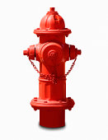
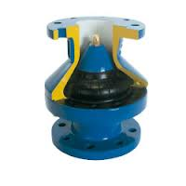
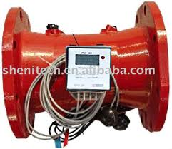
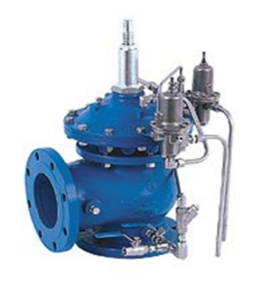
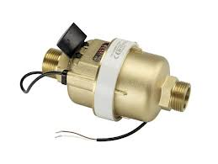
Preventive maintenance in practice
Preventive maintenance comprises all activities undertaken to prevent malfunctions and/ or to extend the life of the assets. Before we do preventative maintenance or inspections a number of conditions must be met:
The location of all pipes and appendages are known and stored in an electronic database (like GIS)
The appendages are accessible
The appendages are boxed and covered with a steel or concrete lit
Examples of appendages are:
Valves
Pressure reduce valves
Non return valves
Fire hydrants
Main water meters
Water meters house connections
Flush points
Distribution pumps
15
Notes:
15

Slide 16
Preventative maintenance: inspection
All network appendages need regular inspection on their state of maintenance and functionality. Inspection involves, checking if:
Appendages are accessible and their protective boxes and nearby surroundings clean
Appendages are clean
Can meters be read?
Are all moving parts inside appendages functioning according to specifications?
The installation of the appendages are correct
Any leakage in the installation?
Meters well-aligned
Are pipes covered with enough soil?
Appendages are working correctly
Can valves be easily be closed and opened?
Correct meter readings
Correct pressure on PRVs
Appendages are in general good state
No corrosion?
Sealing ring, edge of nozzle and slotted ring in good condition?
What is the age of the appendages vs factory life-time (especially for customer meters)
Location of appendages correspond with GIS data
16
Notes:
16

Slide 17
Inspection: valves
The procedures for the checking plain valves:
Check if the valve can easily be closed and opened
Check if the valve is not leaking
Check if the valve is not corroded
Repaint if necessary
Open and close the valve five times to flush coarse grime
Pressure reduce valves:
Check outlet pressure with a manometer when no flow is occurring
Check the filter on contamination. Clean filter if necessary
Check if the sealing ring, edge of nozzle and slotted ring are in good condition if necessary replace the entire valve insert
Re-check outlet pressure again. Adjust pressure setting PRV if necessary.
17
Notes:
17

Slide 18
Inspection: valves
Non-return valves:
Check if the non-return valve is working
Remove all coarse grime and accumulated scale inside the non-return valve
Check if all moving parts inside the non-return valve are functioning according to specifications
Check if the non-return valve is not corroded
Repaint if necessary
Re-install the non-return valve
Make sure that the seals of the valve are in good condition
Check if the non-return valve is not leaking.
18
Notes:
18

Slide 19
Inspection: fire hydrants
Fire hydrants (above ground):
Check if the caps on the couplings are functioning.
Check if the couplings for hoses on the fire hydrant are in good condition.
Open the fire hydrant completely and flush until clean water appears.
Repaint if necessary
19
Notes:
19

Slide 20
Inspection: bulk water meters
Bulk water meters:
Check on a regular basis if the water meters are still running and check the data from the data collection system with an actual reading of the meter
If a water meter is malfunctioning:
Close the isolating valves on both sides of the water meter
Unscrew the bolts to remove the water meter
Check the inside of the water meter on coarse grime, accumulated scale or blockades
Wash and clean the inside of the water meter with clean water in order to remove all dirt
Check if all components are functioning according to specifications
Check if the body from the water meter is not corroded. Repaint if necessary
Re-install all internal components in reversed order and fasten and tighten all bolts
Re-install the water meter
Make sure that the seals fit properly
Open the isolating valves besides the water meter
Check if there is no is leakage
20
Notes:
20

Slide 21
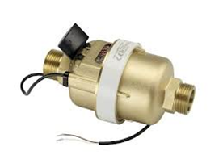
Inspection: house connections
House connections, including water meters:
Check if the water meter is visible, accessible and clean
Check if client number, water meter numbers, etc. are complete according to the standard of the customer/connections database
Check if all components from the house connection are working according to specifications
Check the house connection on illegal sub connections
If the life time of the water meters is exceeded, replace the waters meter (according to the standard) for a new or rehabilitated water meter
Check if the water meter is not installed upside down (illegal consumption by deviation)
21
Notes:
21

Slide 22
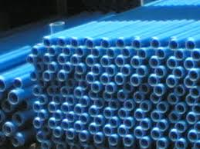
Inspection: Pipelines
Checks of the surrounding area
All pipelines must be covered with enough soil
Check if all pipelines are accessible. No houses, big trees or other obstructions may be located on top of the pipelines
Pipelines that cross roads need extra attention. Leakages occurring here can cause a lot of traffic problems. The use of a casing is advisable if frequent leakage occurs
Checks on functionality
Check the pipelines for leakages. This can be done through field inspection, complains from customers or analyzing data
Measuring the turbidity of the water transported. If the turbidity of the water is too high flushing plan must be made to clean the pipelines. This plan also contains the frequencies of cleaning
Check pressures and flows by analyzing data from the data collection system
A condition for inspection and maintenance is that the (correct!) location of all distribution pipelines must be stored in an electronic database (i.e. GIS).
22
Notes:
22

Slide 23
Preventative maintenance
All network appendages need regular maintenance, which includes activities such as:
Cleaning
Remove all coarse grime and accumulated scale inside the appendages (filters, meters, valves)
Take apart appendages, clean all bits and put back together
Repainting
For protection
For visual effect: appendages that look functional will be less likely abused
Start and stop pumps
Repairing or replacing appendages or parts of appendages that are in bad state
23
Notes:
23

