Slide 1
Leak Detection
Night Flow Measurement, Step Testing, Leak Detection Equipment

Slide 2
Content
Leakage Components
Leak Detection
Leak Detection Equipment

Slide 3
Leakage components
Background leakage, bursts

Slide 4
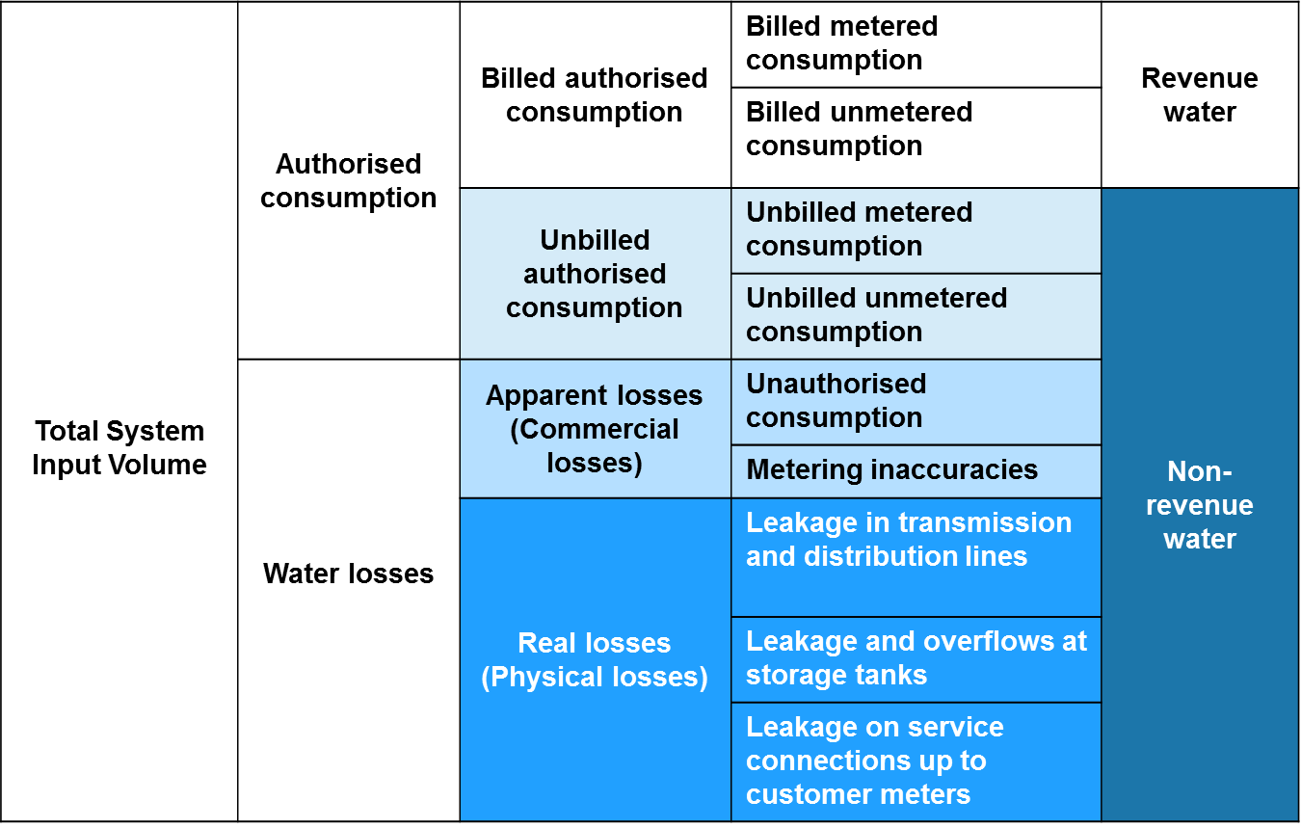
Leakage components
4
Notes:
4

Slide 5
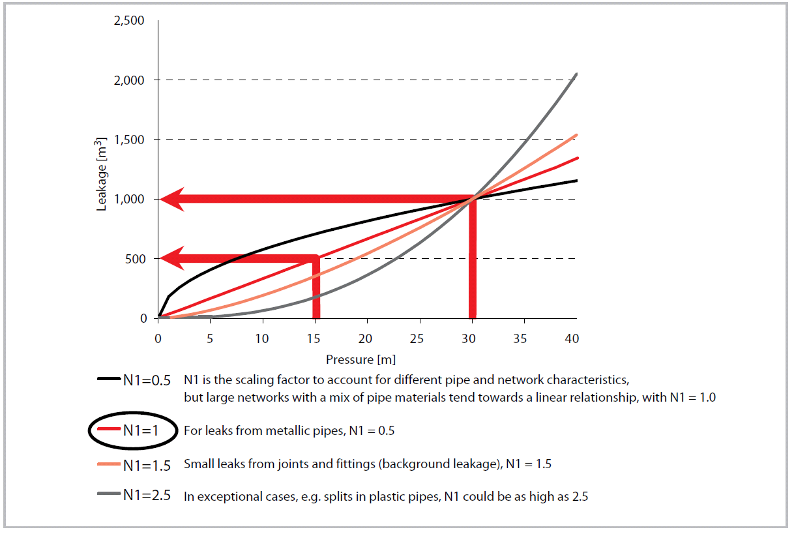
Background vs burst leakage
Background Leakage
The aggregation of leakages from all fittings on the distribution network that are too small to be detected by visual or acoustic inspection
Background leakage are individual leaks with flow rates less than 0.25 m3/hr at 50 m pressure - the minimum leak that can realistically be detected with modern technology
Major influence: pressure
Burst Leakage
Loss of water resulting from bursts on the distribution network
Major influence: the speed with which the burst is located and repaired
*Amount of water loss through leakage varies during the day as it depends on the pressure
5
Notes:
5

Slide 6
2. Leak detection
Minimum nightflow, step testing

Slide 7
Minimum Night Flow
Amount of water loss through leakage can be estimated with Minimum Night Flow (MNF) testing
The MNF is the lowest hourly average flow into the DMA over a 24-hour period,
MNF is usually obtained between 2 and 4am, when most tanks have been filled and users are asleep
The Legitimate Night Flow (LNF) is the customer minimum night consumption at the time of minimum night flow
Domestic customers – toilet flushing, washing machines etc; use a standard legitimate night time factor, or measured sample
Large nightly users (such as night clubs or industries) – manually read or log their meter or use a portable meter
The Net Night Flow (NNF) is the DMA leakage at the time of minimum night flow: what remains after subtracting the LNF from the MNF
Some of the leakage occurs on the customer’s premises and therefore is not part of the utilities NRW. As such, the NNF should be divided into ‘Utility leakage’ and ‘Customer leakage’

Slide 8
Minimum Night Flow
Identify the MNF (using a logged DMA meter)
Identify the typical LNF
Calculate the NNF = MNF – LNF
Estimate the ‘Utility leakage’ UNNF = NNF – ‘Customer leakage’
As leakage is proportional to pressure, to represent the average leakage through the day the UNNF should be corrected with a pressure factor (pf), typically pf = average daily DMA pressure / average MNF pressure
Average DMA leakage = UNNF*pf
8
Notes:
8

Slide 9
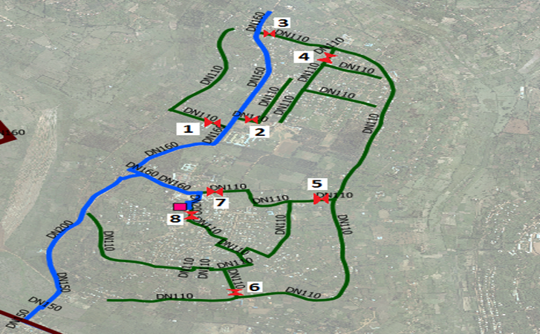
Example
9
Notes:
9

Slide 10
Step testing
Step testing is a method in which parts of the DMA network are successively isolated to narrow the possible location of leaks
Select the first step furthest away from the DMA water meter
Each step should take around 20 minutes to see the impact
Flow as well as pressure should be checked
Big drop in flow and increasing pressure indicates leakage
Undertake step testing during night time (00.00 – 04.00 am) to avoid measurements disturbed by fluctuations in water demand
First cut off the water supply
10
Notes:
10

Slide 11
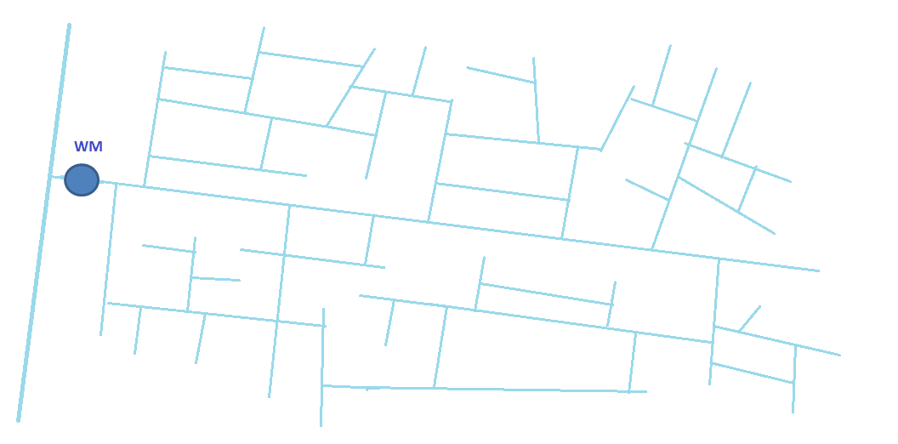
Step testing example

Slide 12
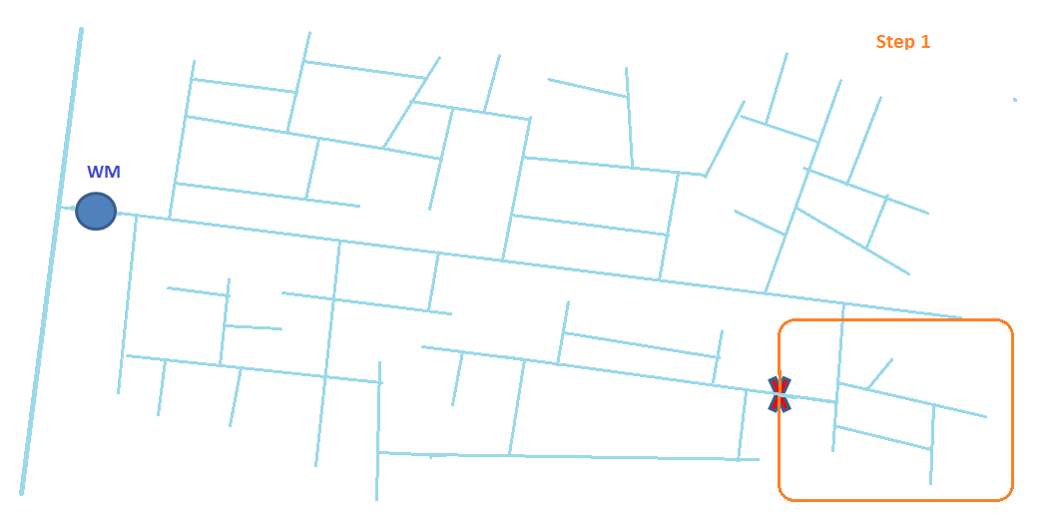
Step testing example

Slide 13
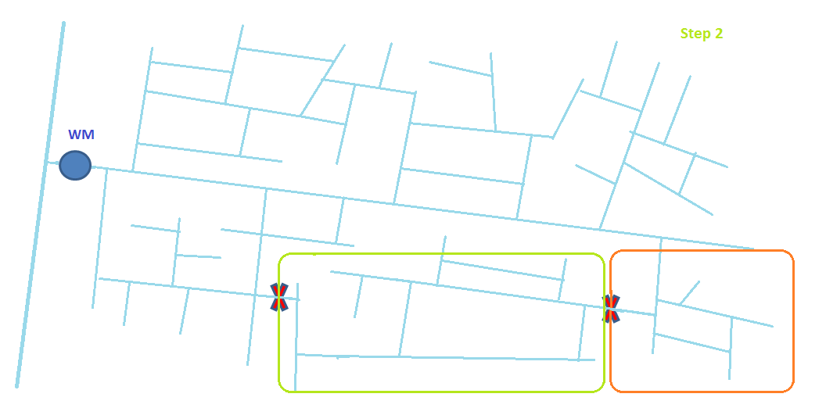
Step testing example

Slide 14
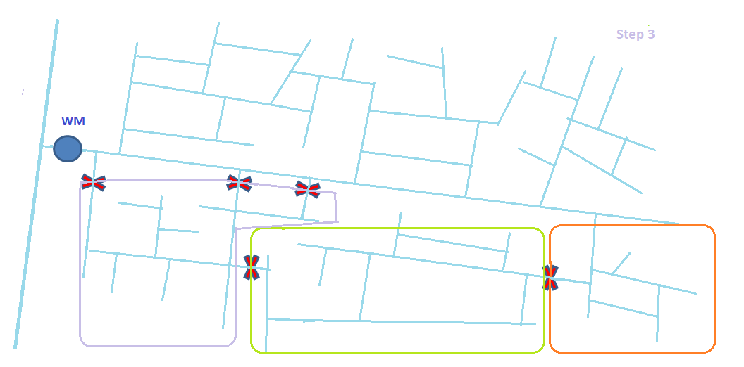
Step testing example

Slide 15
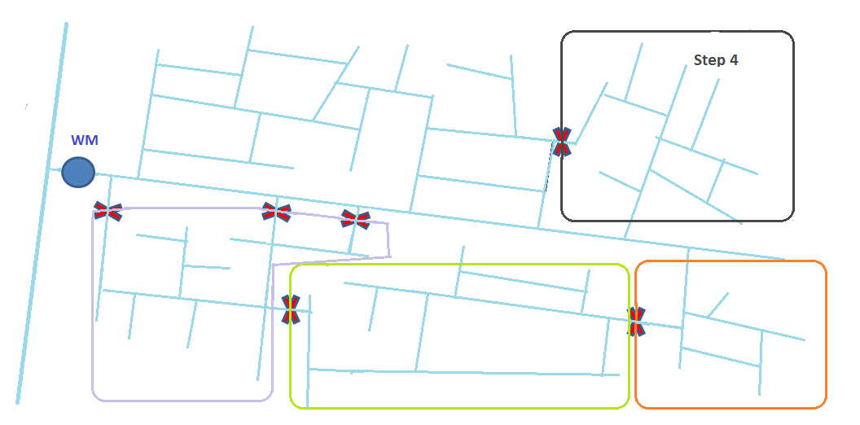
Step testing example

Slide 16
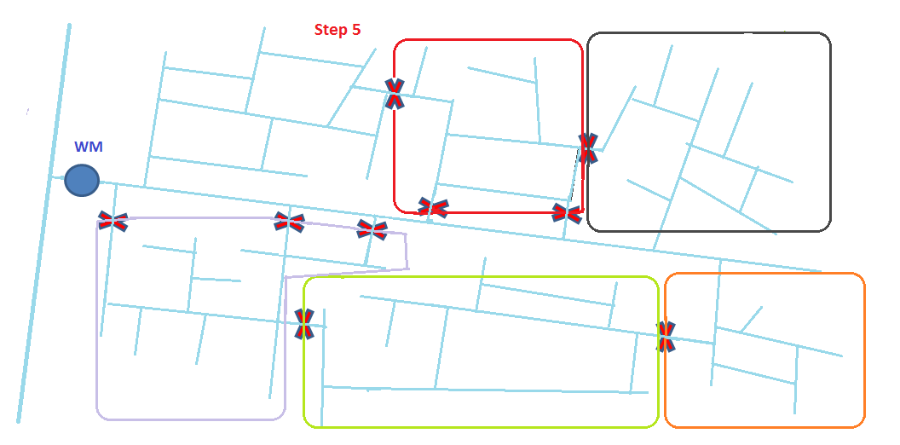
Step testing example

Slide 17
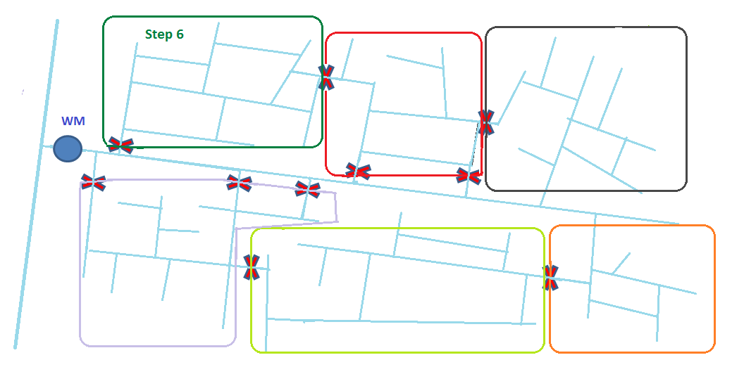
Step testing example

Slide 18
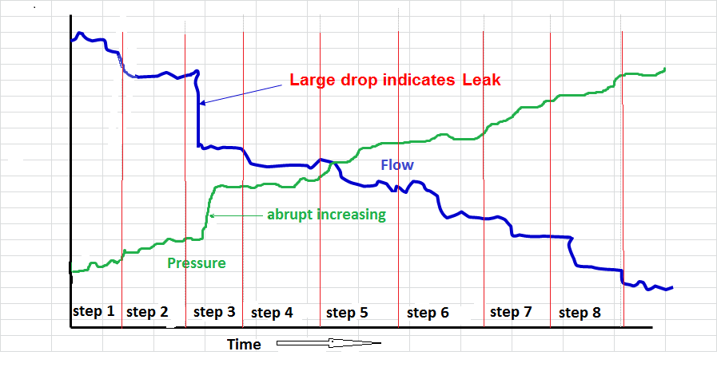
Step testing example
Relation flow/pressure and time

Slide 19
3. Leak detection equipment
Clamp-on meter, accoustic meter

Slide 20
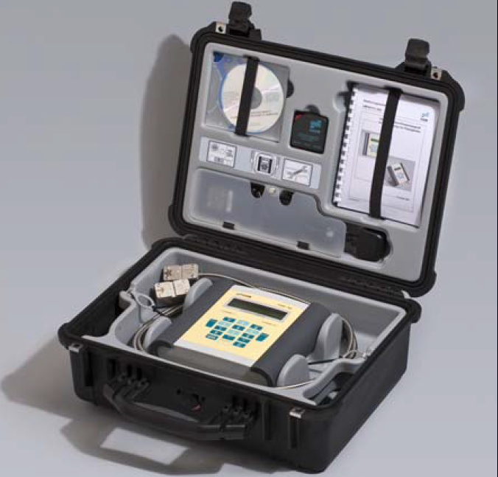
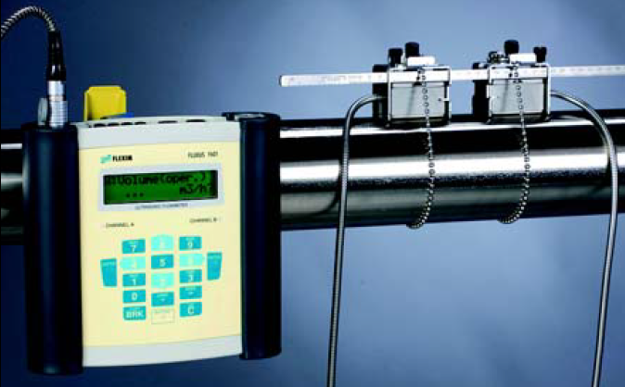
Clamp-on meter
A clamp-on meter is a portable meter with which flows can instantaneously be measured through pipes of different types and sizes. Clamp-on meters are used:
When measurements are needed in location where no meters are installed
To check the accuracy of installed meters
Furthermore,
Accuracy of < 1% possible
A clamp-on meter are expensive (~10.000 Euro) and security is needed during night flow measurements
Clamp on meter in box and installed

Slide 21
Clamp on meter, quick start guide

Slide 22
Accoustic Meter
Amo

Slide 23
Other?
Amo

